Slide 1

OJAY WEBSITE USER EXPERIENCE & PROTOTYPE - VERSION 1

Slide 2
OJAY ONLINE STORE
This is the user experience and prototype designs for a new online fashion store for OJAY,
The brand is crisp and clean, projecting a premium mood for women. The product includes killer classics, desk to date and weekender occasions.
The UX concept is for an immersive shopping experience, where customers can explore the collections and brand content and shop directly from it.
OJAY WEBSITE INFORMATION ARCHITECTURE

Slide 3
TOTAL BESPOKE TEMPLATES
HOME
SHOP THE LOOK
NEW ARRIVALS
SHOWCASE
OCCASION
NEW ARRIVALS
SHOP BY PRODUCT
SAVED ITEMS
GIFT CARD LANDING
PRODUCT DETAIL
GIFT CARD DETAIL
INSTASHOP LANDING
INSTASHOP MODAL
BLOG
CUSTOMER SERVICE
RETURNS, DELIVERY INFO, ABOUT US
PRIVACY POLICY
DEFAULT COMMERCE TEMPLATES
DEFAULT WITH CSS MODIFICATIONS
SHOPPING BAG
CHECKOUT
ACCOUNT/PROFILE
OJAY WEBSITE INFORMATION ARCHITECTURE

Slide 4
LOGIN / ACCOUNT
HOME PAGE
SIGN UP
SHOPPING BAG
SHOP
- SALE -
PRODUCT CATEGORY
INSTASHOP
MAGAZINE LANDING
GIFT CARD
CUSTOMER SERVICE
- About us
- Contact
NEW ARRIVALS
POST
ISSUE #
CARD DETAILS FORM
SHOP THE LOOK
CAMPAIGN
SHOWCASE
PRODUCT DETAIL
CONTACT FORM
PRODUCT HIGHLIGHT
SHOP BY OCCASION
RETURNS
THE LOOK FLAT LAY
SHOP BY PRODUCT
INFLUENCER CONTENT
SHIPPING INFO
PRODUCT DETAIL
PRIVACY POLICY
SIZING
OJAY WEBSITE INFORMATION ARCHITECTURE

Slide 5

NAVIGATION

Slide 6
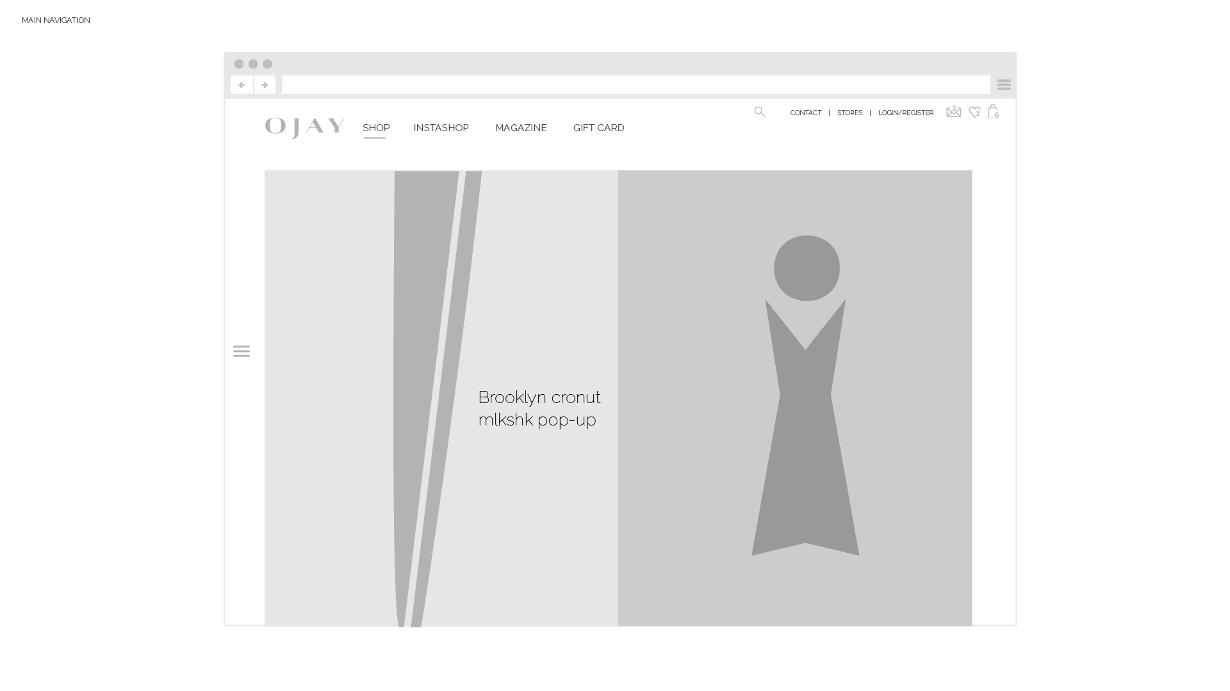
OJAY WEBSITE INFORMATION ARCHITECTURE

Slide 7
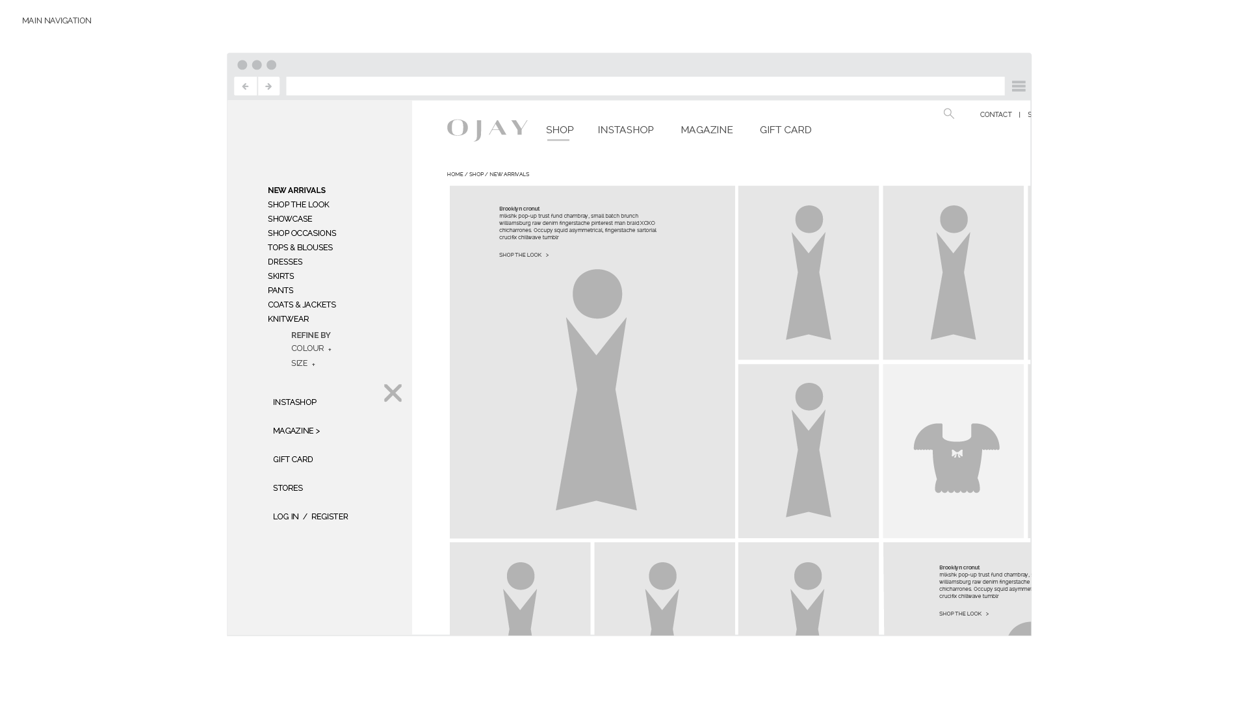
SIDE BAR NAV
Selecting SHOP in the main menu will load the New Arrivals page, then push open the side bar.
The side bar pushes in from left.
Ref 1: You can see “slide in” and “Push In” styles here. Our site will not black out the page like these samples though.
http://callmenick.com/_development/slide-push-menus/
Ref 2: another push in sample closer to what we would create.
http://bootsnipp.com/snippets/featured/fancy-sidebar-navigation
OJAY WEBSITE INFORMATION ARCHITECTURE

Slide 8
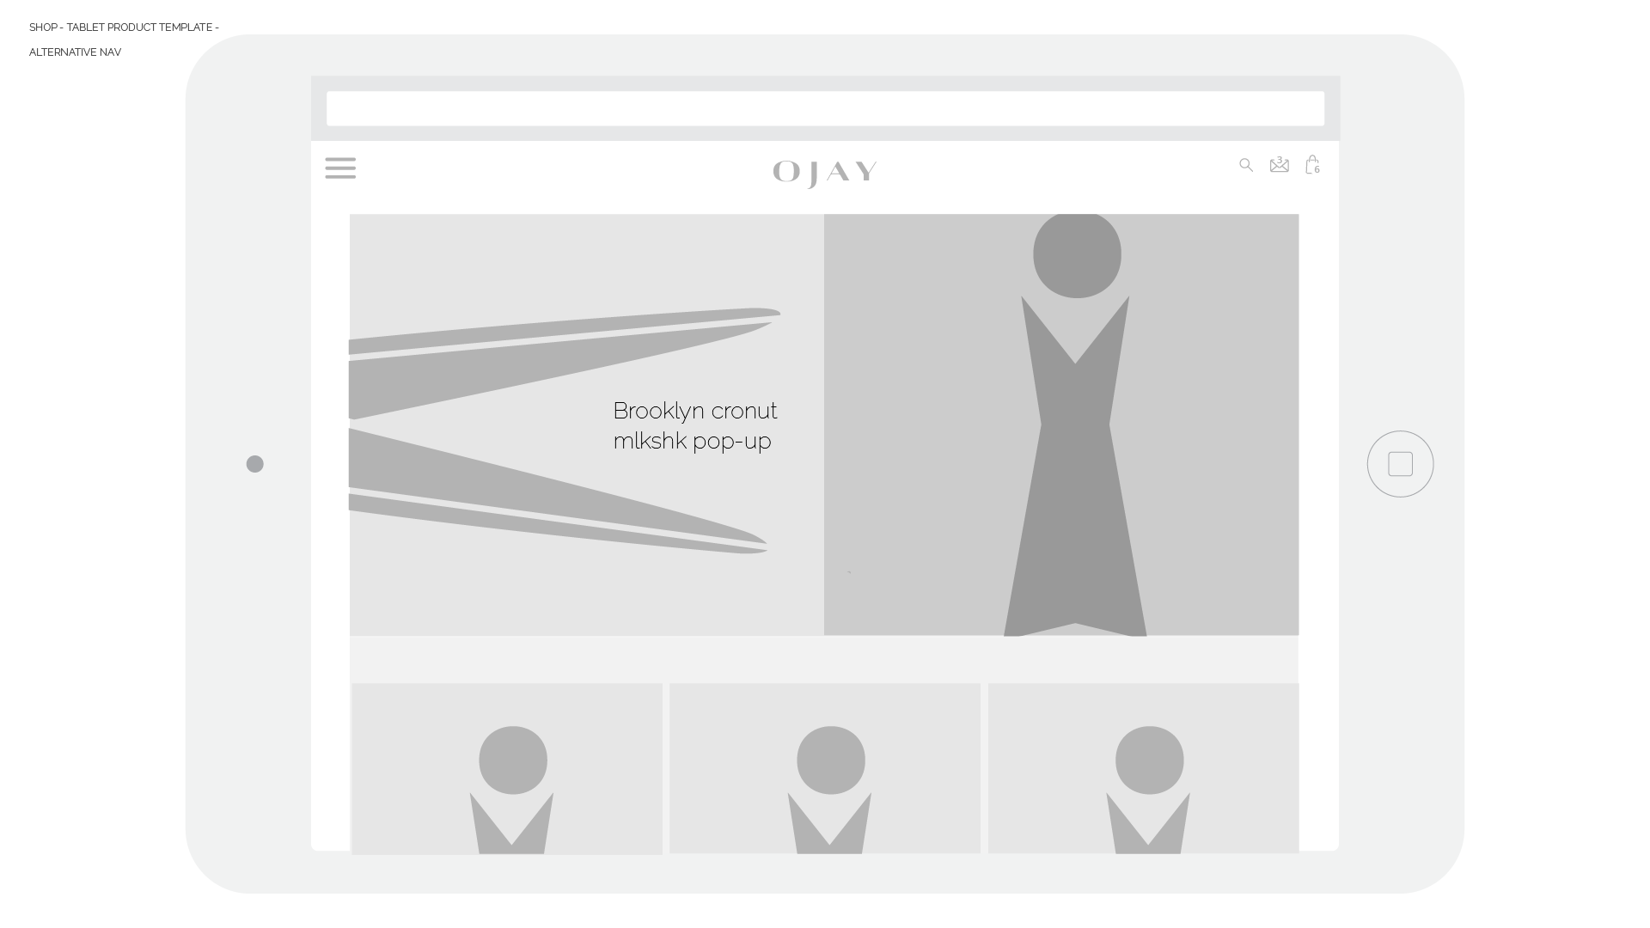
OJAY WEBSITE INFORMATION ARCHITECTURE

Slide 9
SHOP THE LOOK

Slide 10
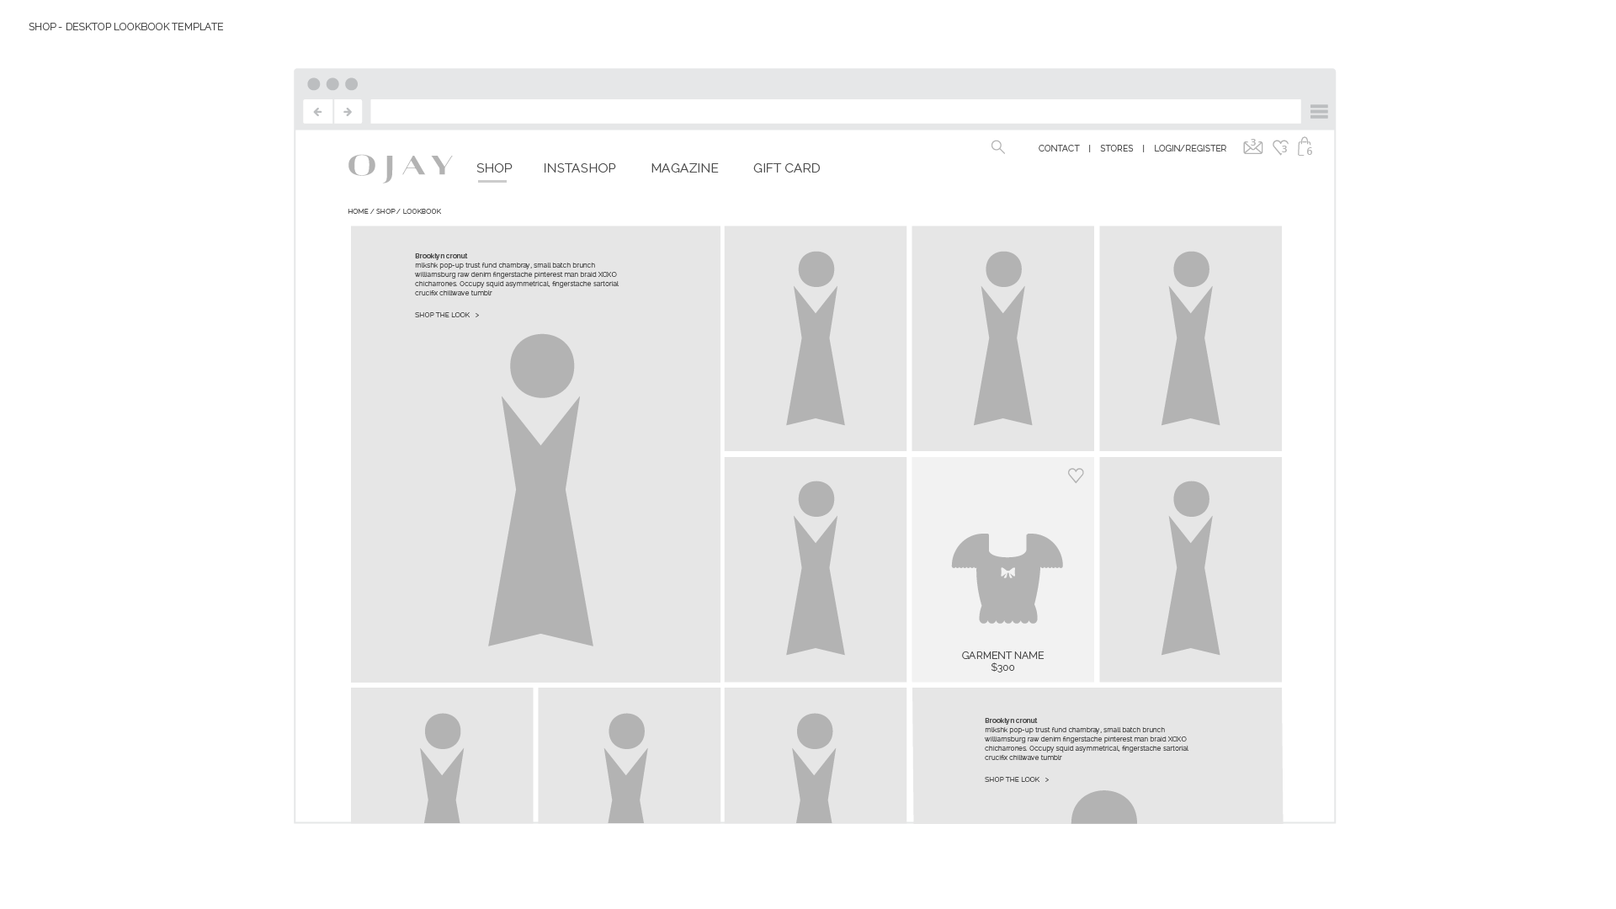
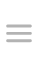
Hover effect references
http://uxcode.net/themes/novu/
OJAY WEBSITE INFORMATION ARCHITECTURE

Slide 11
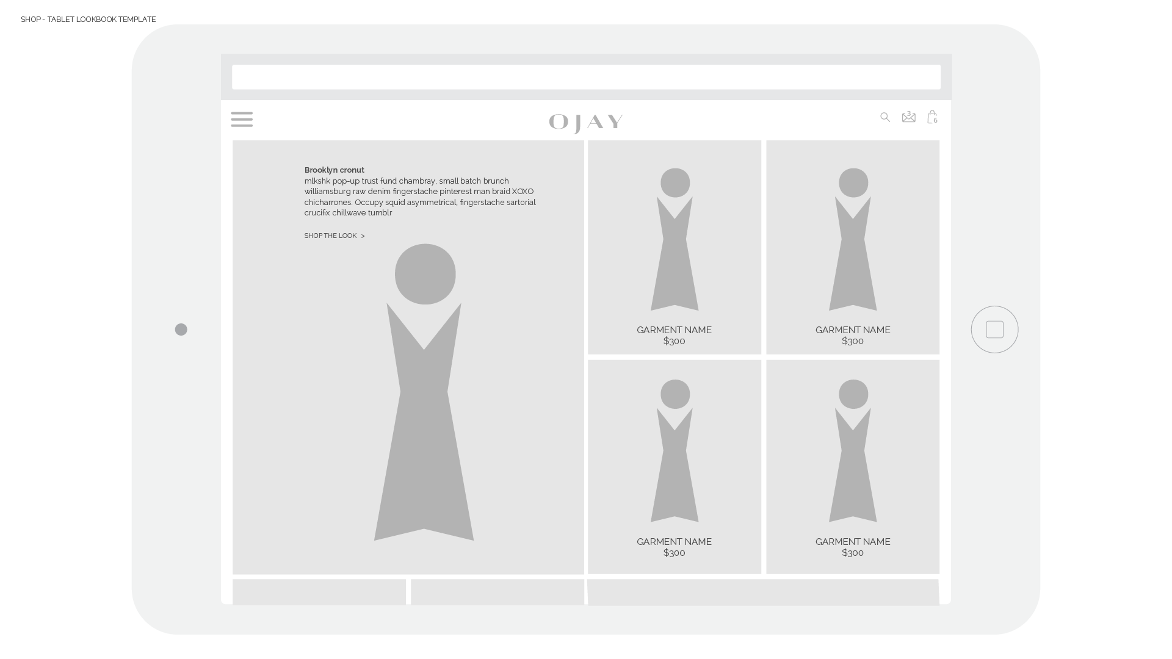
OJAY WEBSITE INFORMATION ARCHITECTURE

Slide 12
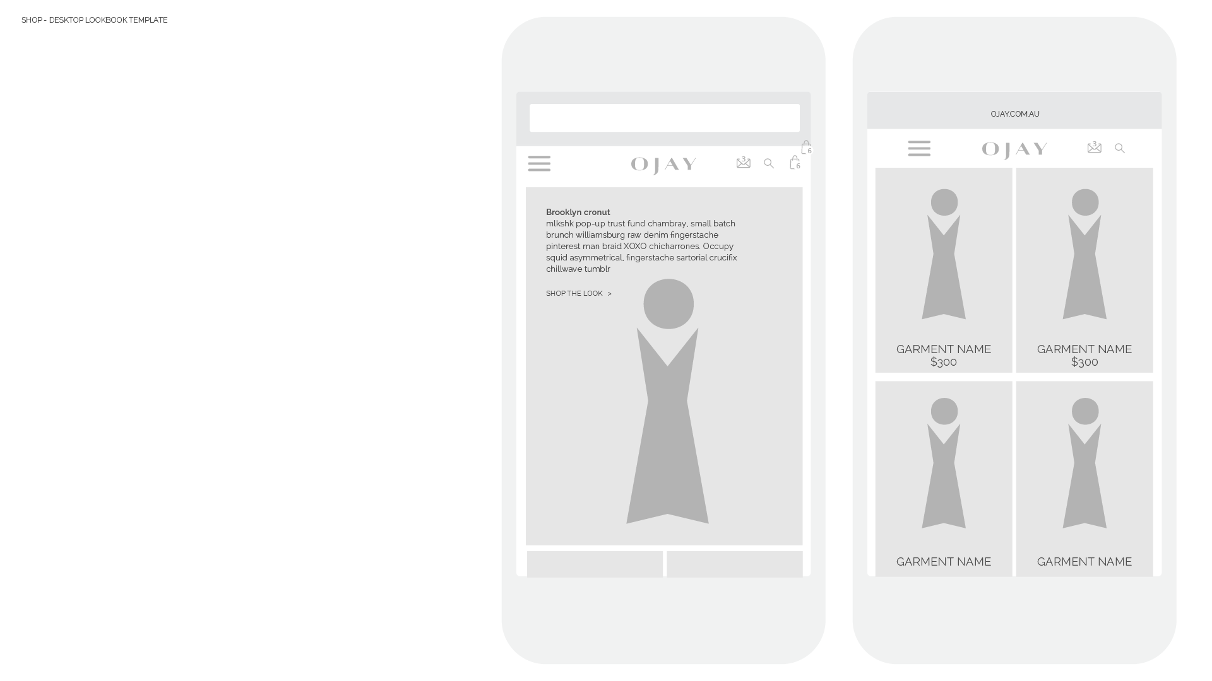

Slide 13
SHOWCASE

Slide 14
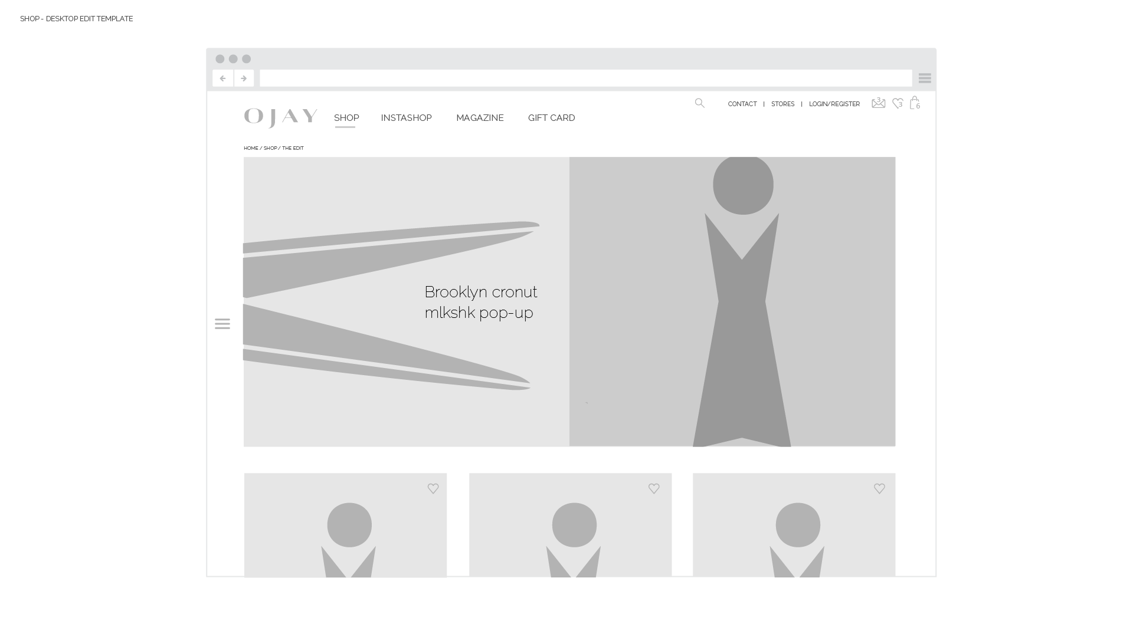
This is where we can highlight feature products, trends or styling ideas for each drop into store.
It’s a great way to really establish the brand’s fashion point of view.
OJAY WEBSITE INFORMATION ARCHITECTURE

Slide 15
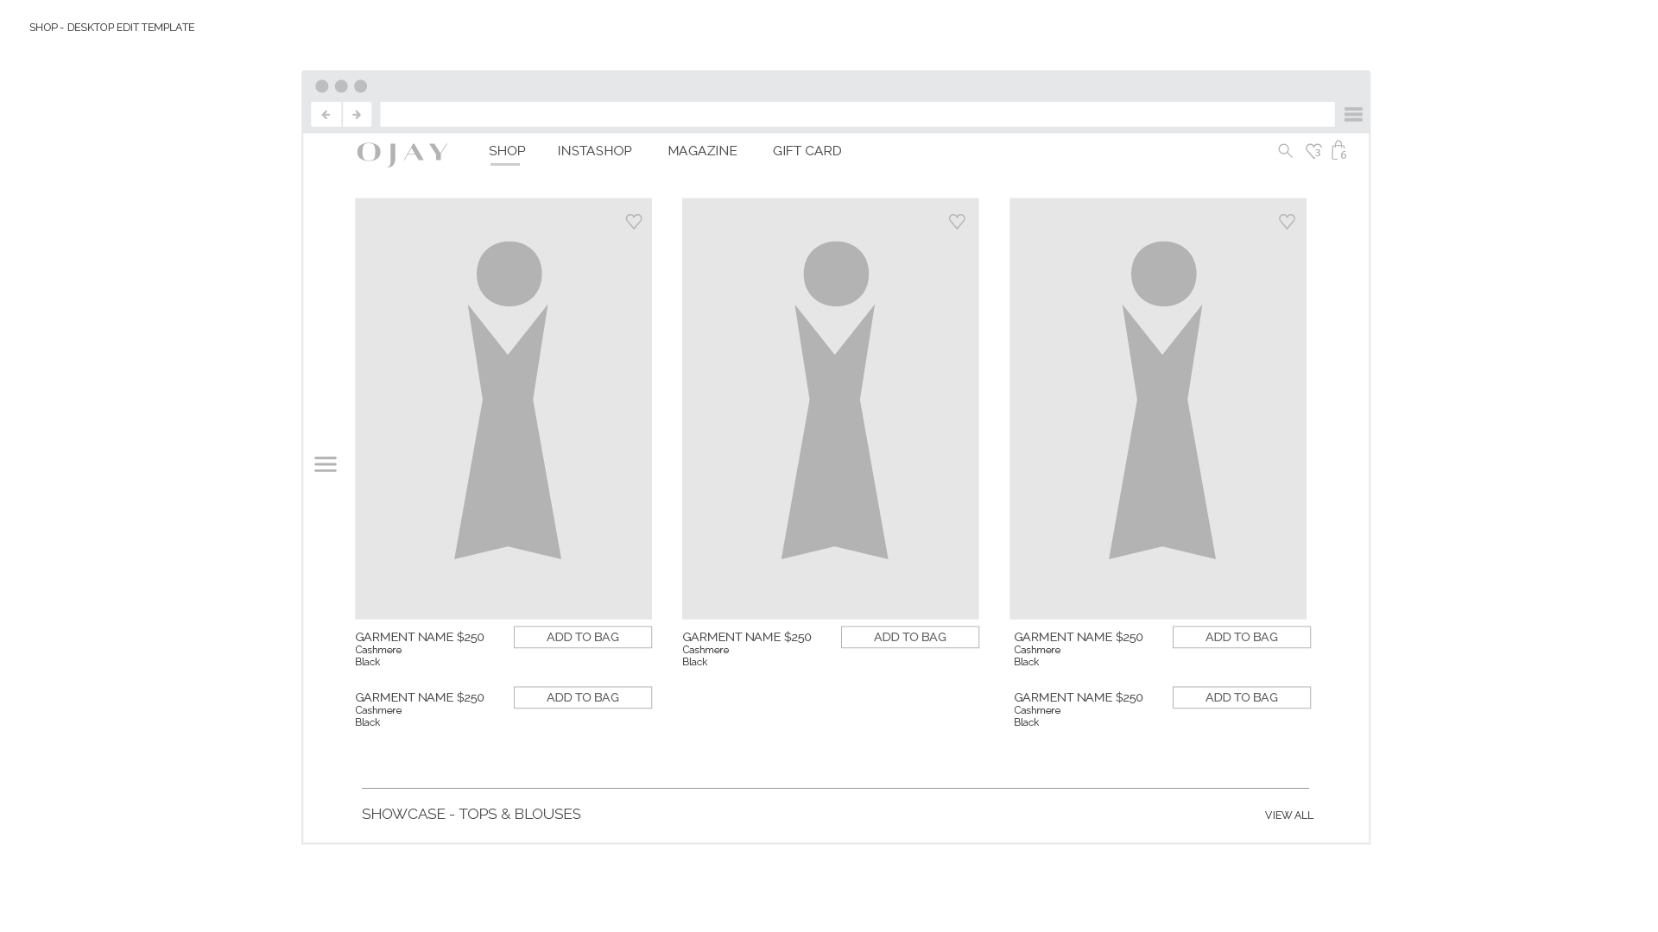
OJAY WEBSITE INFORMATION ARCHITECTURE

Slide 16
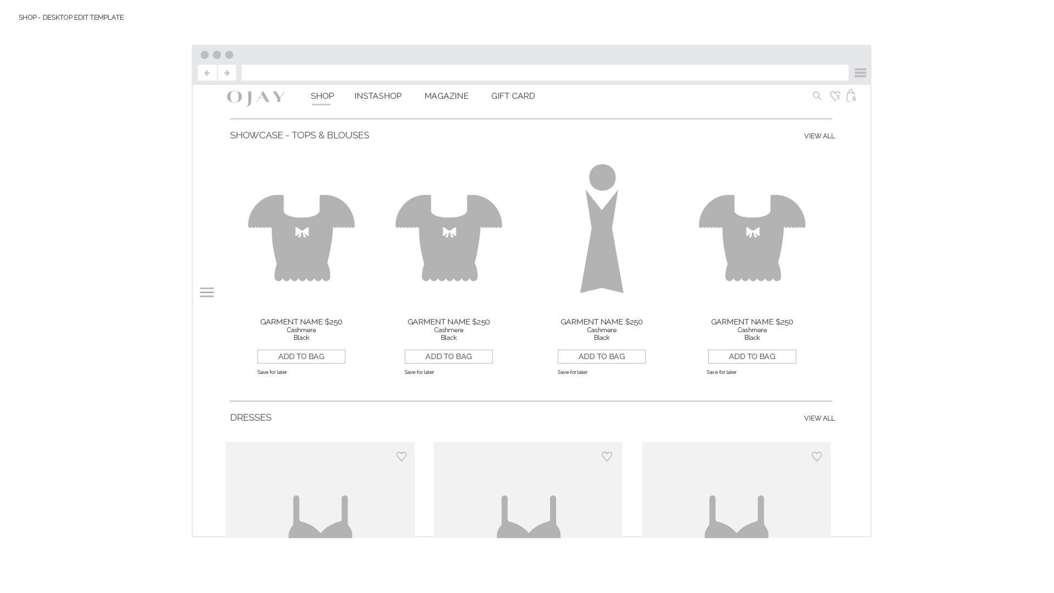
After the “looks” images the page has content rows for products.
The categories of product can be chosen in the CMS.
Each row has a different styling for variation & interest. Makes the Showcase feel richer and less repetitive to other other pages.
OJAY WEBSITE INFORMATION ARCHITECTURE

Slide 17

OJAY WEBSITE INFORMATION ARCHITECTURE

Slide 18
OJAY WEBSITE INFORMATION ARCHITECTURE

Slide 19
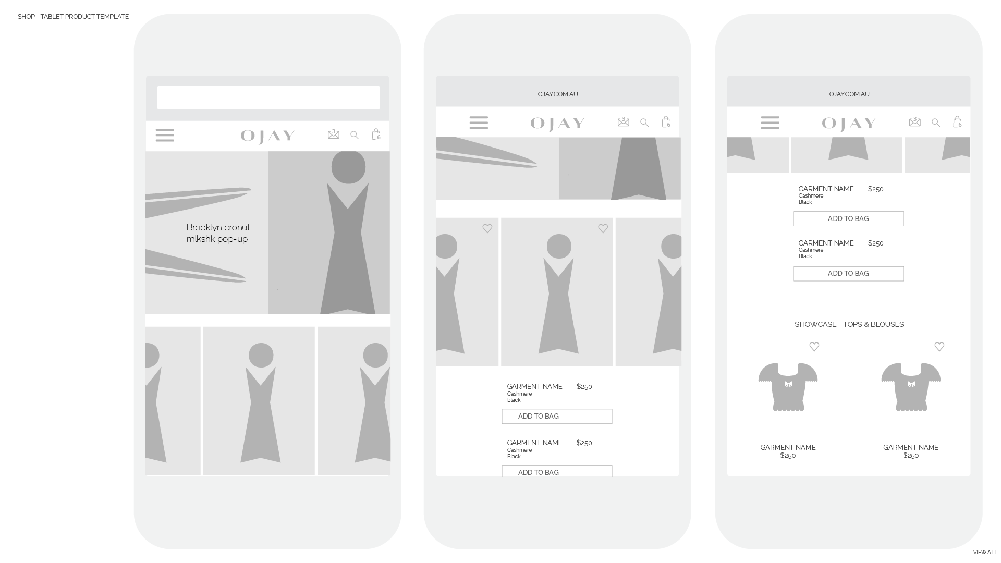
OJAY WEBSITE INFORMATION ARCHITECTURE

Slide 20
SHOP BY PRODUCT

Slide 21
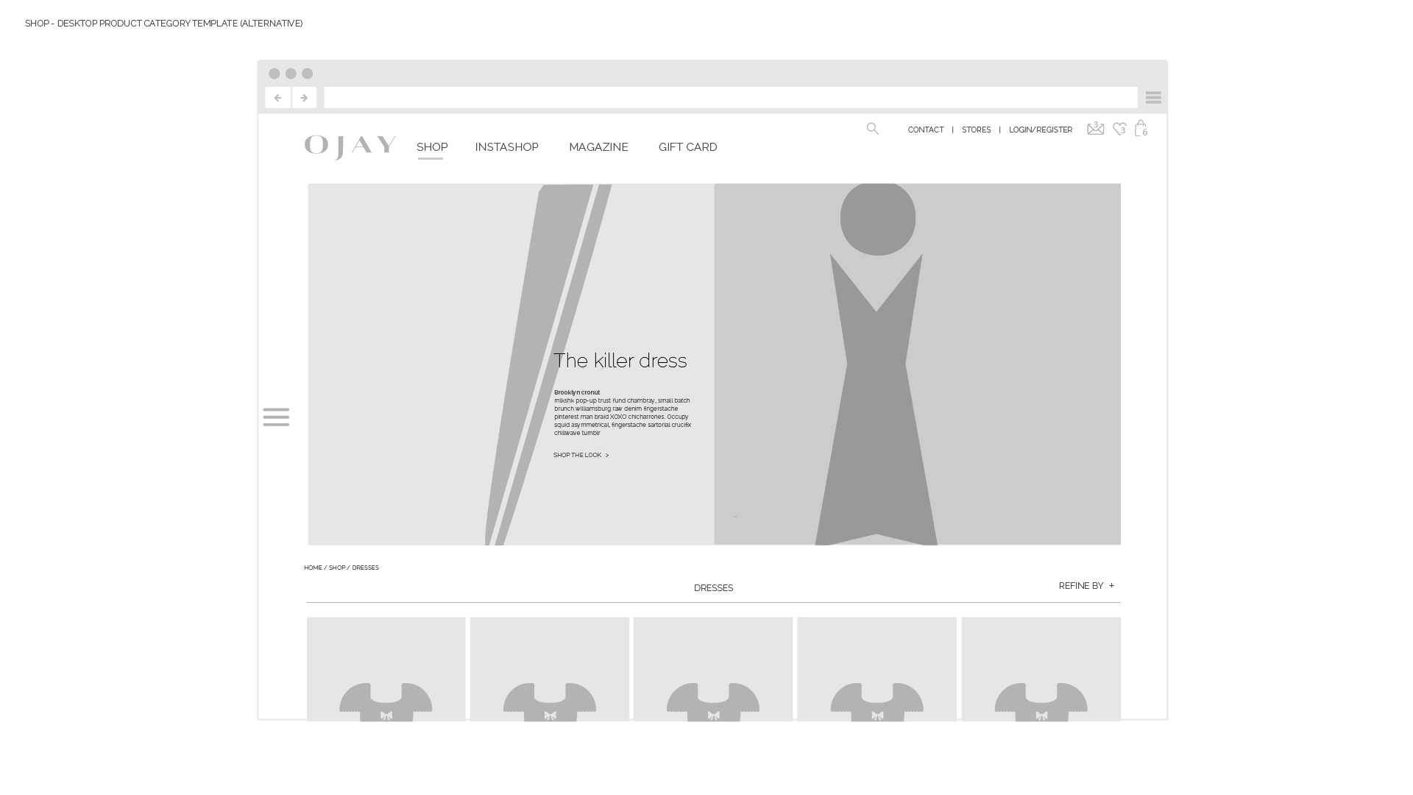
The text in the header image is HTML. It’s better for search and it’s responsive.
- This means it is a separate layer to the image.
- It is editable in the CMS
- The position can be selected within a few set options.
- It will appear in a slightly different place on the image depending on the user’s browser size.
- Will look crisp and readable on mobile and tablet.
OJAY WEBSITE INFORMATION ARCHITECTURE

Slide 22
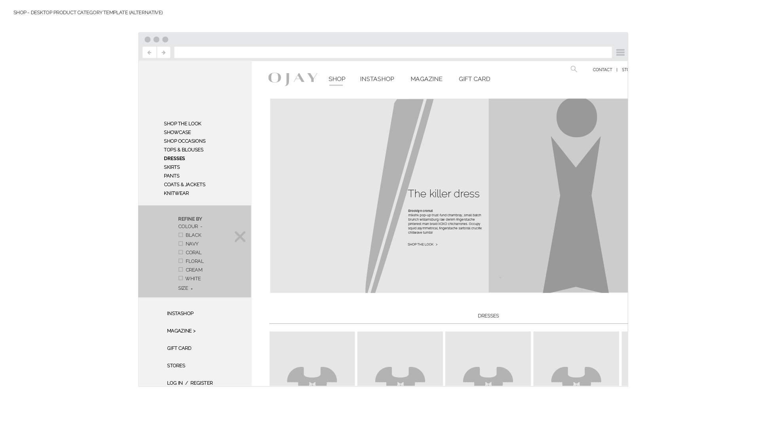
The Refine filter in its open accordion state.
The content in the slide out side bar is dynamic - in that depending on what page the user is on, different additional lists will be shown.
The standard navigation will always remain:
Shop the look
Showcase
Shop occasions
List of product categories
Instashop
Blog/magazine
Gift Card
Stores
Login / Register
On a product category page - refine options show under the categories.
On a Shop the Look page, the refine options do not show.
OJAY WEBSITE INFORMATION ARCHITECTURE

Slide 23
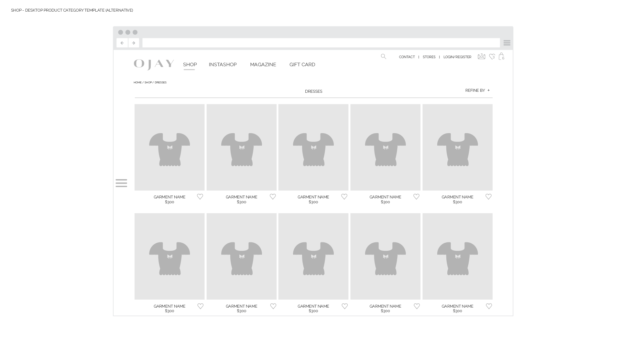
OJAY WEBSITE INFORMATION ARCHITECTURE

Slide 24
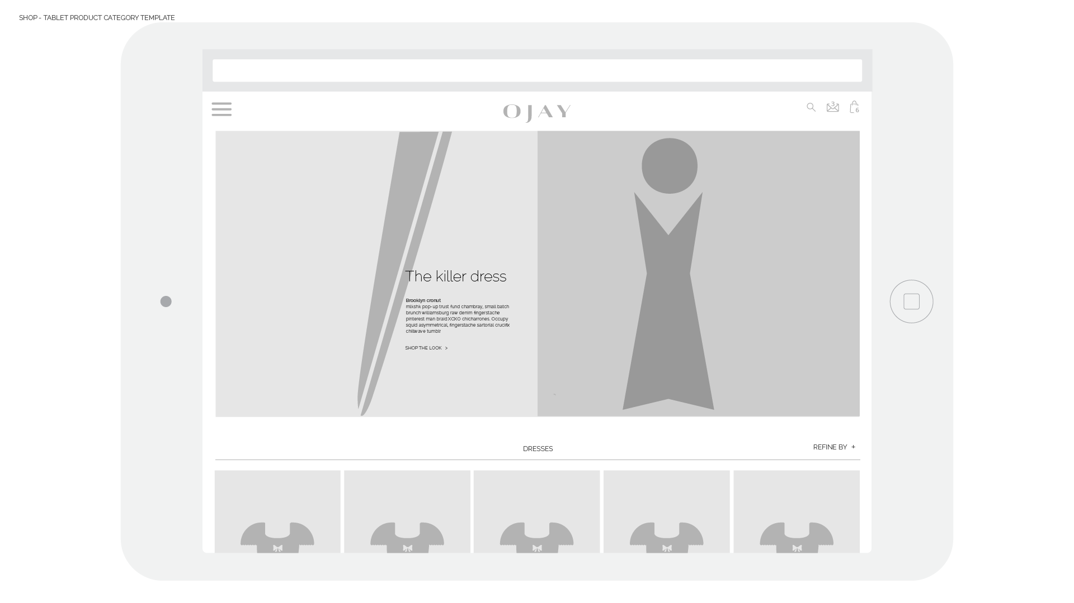
OJAY WEBSITE INFORMATION ARCHITECTURE

Slide 25
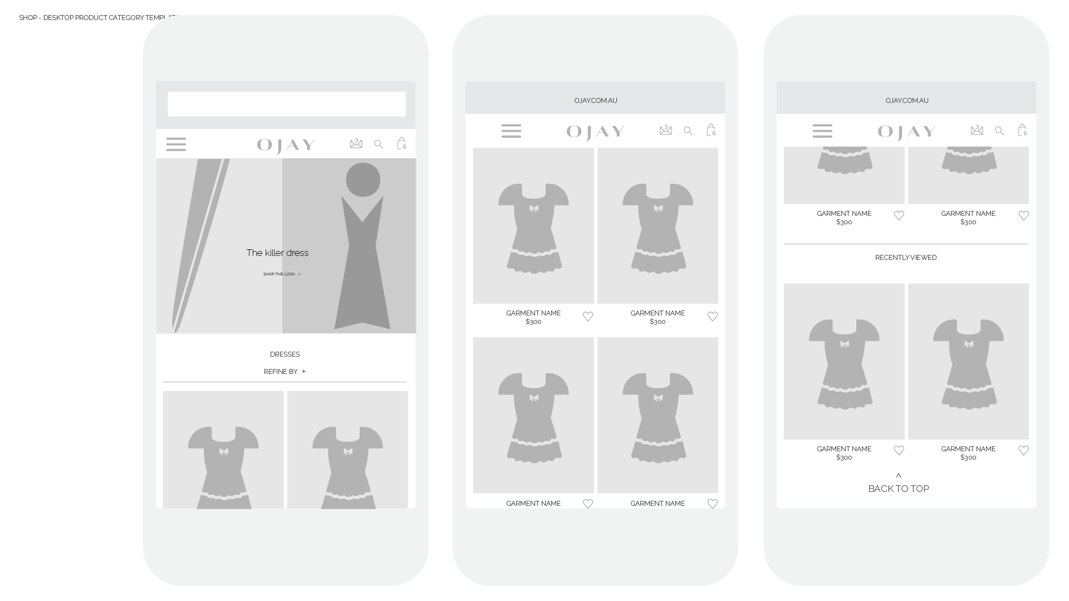
OJAY WEBSITE INFORMATION ARCHITECTURE

Slide 26
SHOP BY OCCASION

Slide 27
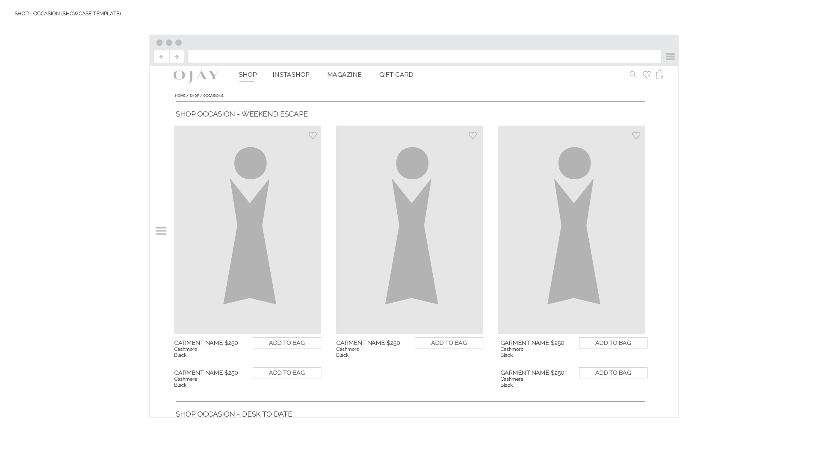
Uses the same template as Showcase pages.
The page is a list of Occasions.
Each “Occasion” can be added as a new content row down the page.
OJAY WEBSITE INFORMATION ARCHITECTURE

Slide 28
PRODUCT DETAIL

Slide 29
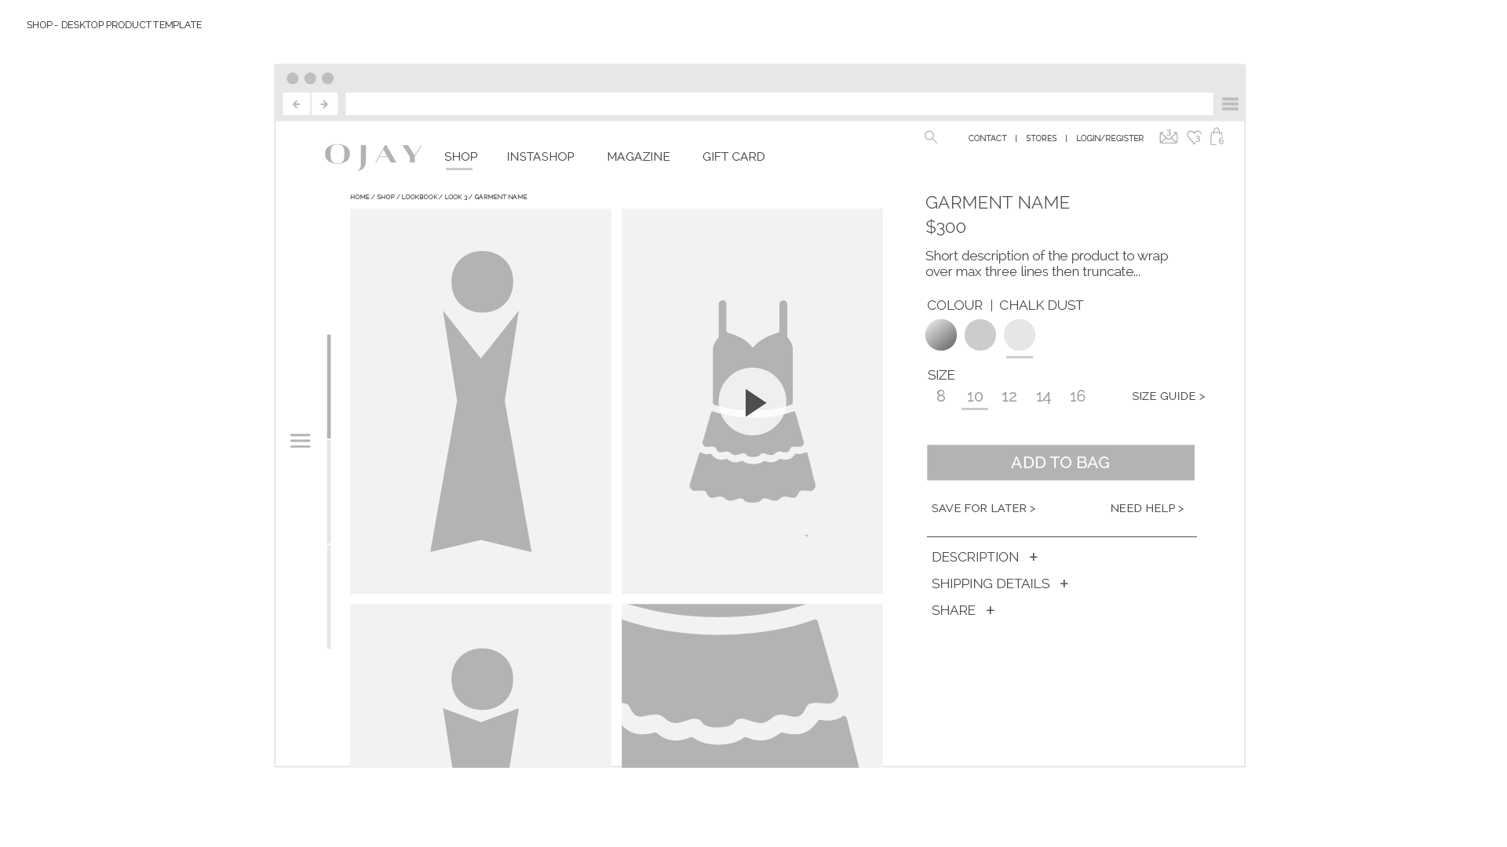
The left of the screen is the image stage. In this area is where images show, zoom views and video.
The stage scrolls.
The right side with the info does not scroll, unless the content in the info requires it.
OJAY WEBSITE INFORMATION ARCHITECTURE

Slide 30
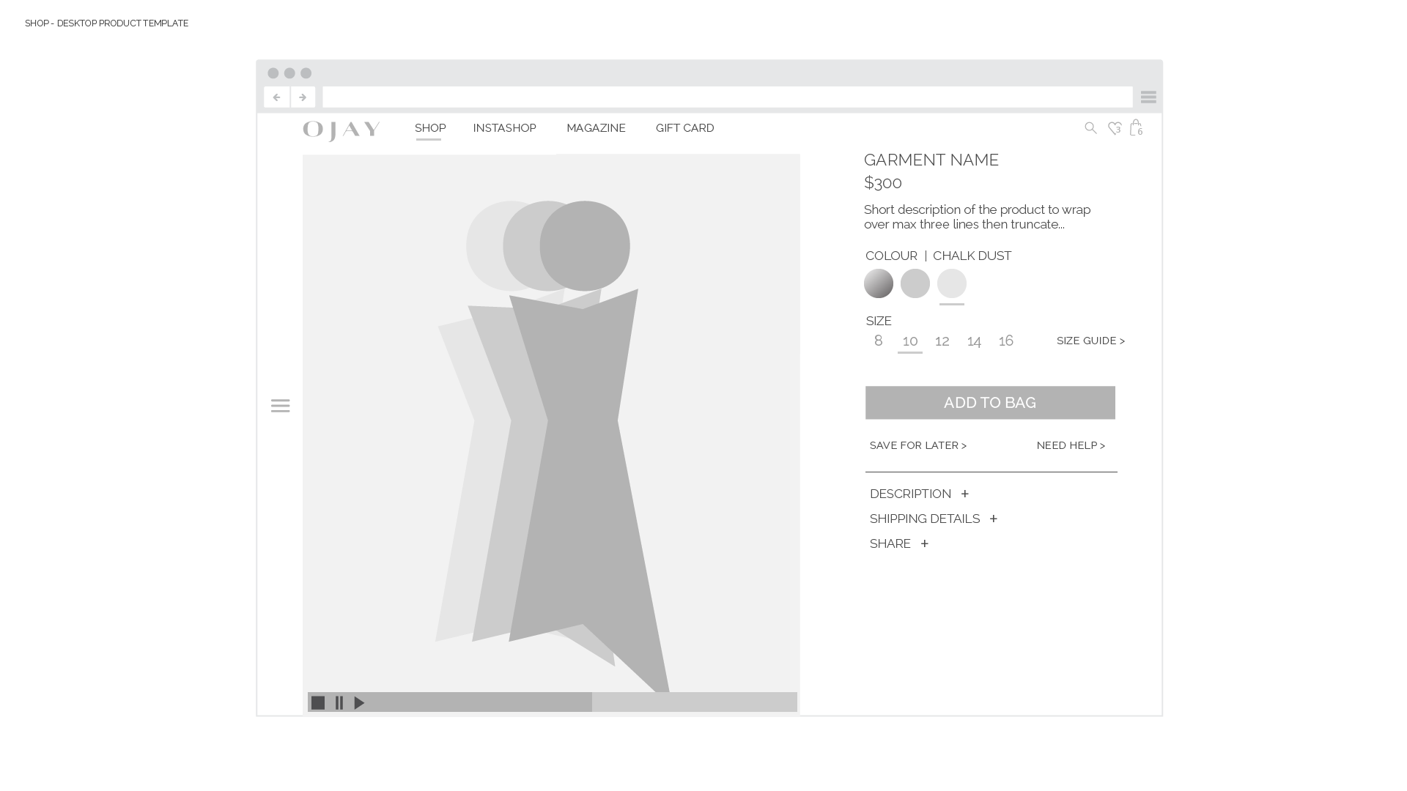
Video plays in the stage.
We will set a video format with consideration to ease of production and design of the page.
X
OJAY WEBSITE INFORMATION ARCHITECTURE

Slide 31
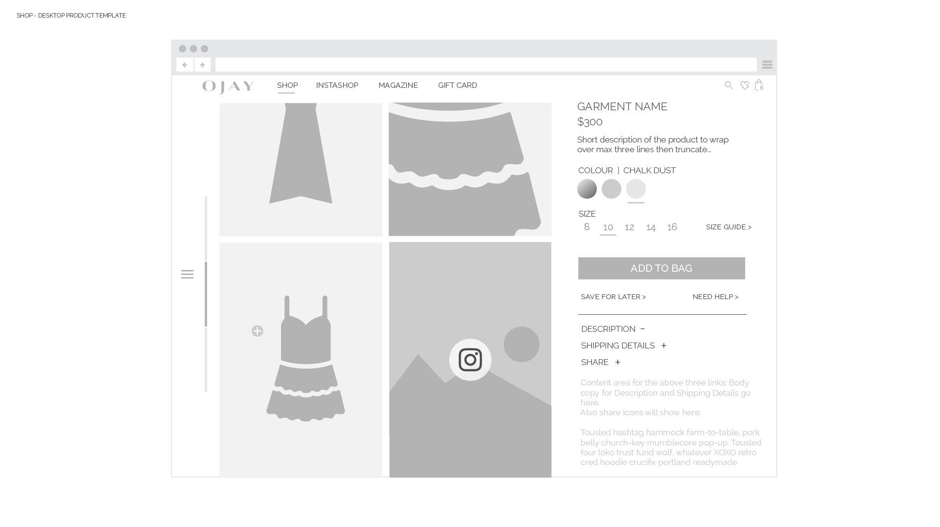
The details section is expanded in this slide.
The content from Shipping Details, Description and share links all populate in this space.
Note the Instagram icon on the bottom right image. If this product is tagged in the instashop, then that instagram image will be populated in here too.
Select this image to open the instashop overlay. (next page)
OJAY WEBSITE INFORMATION ARCHITECTURE

Slide 32
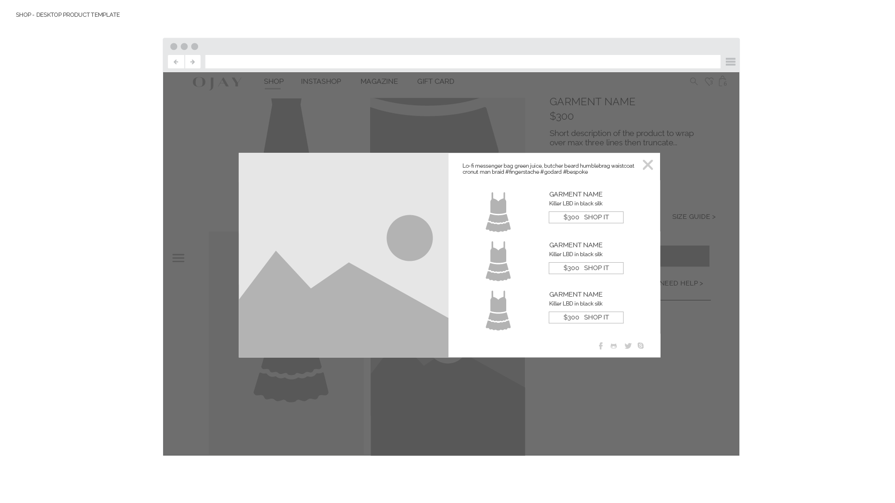
The instashop overlay is a modal over the current page you’re on. It does not link through to the instashop page.
Closing the overlay leaves you on the product you were looking at previously.
OJAY WEBSITE INFORMATION ARCHITECTURE

Slide 33
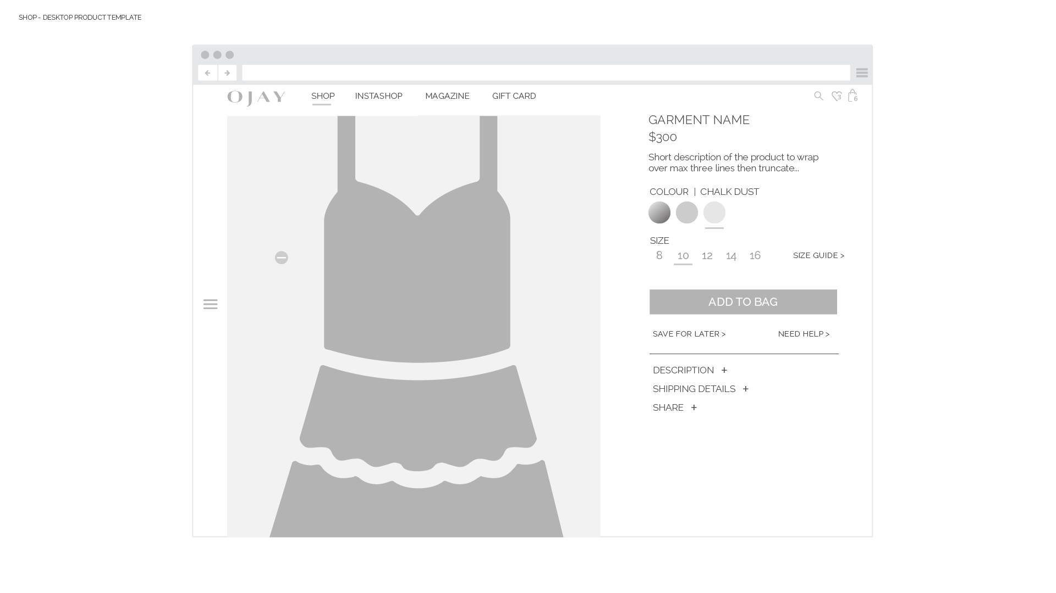
Zoom view, populated in the stage.
OJAY WEBSITE INFORMATION ARCHITECTURE

Slide 34
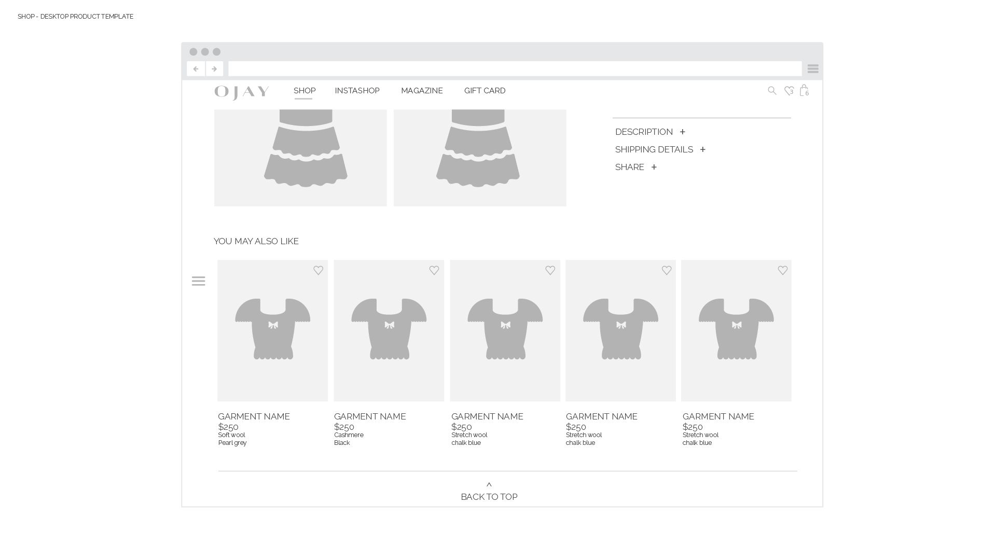
In the “You may also like” section, the first images in the row will be any product that appears in the “Look” image associated with this product. Then other products that go well with it.
OJAY WEBSITE INFORMATION ARCHITECTURE

Slide 35
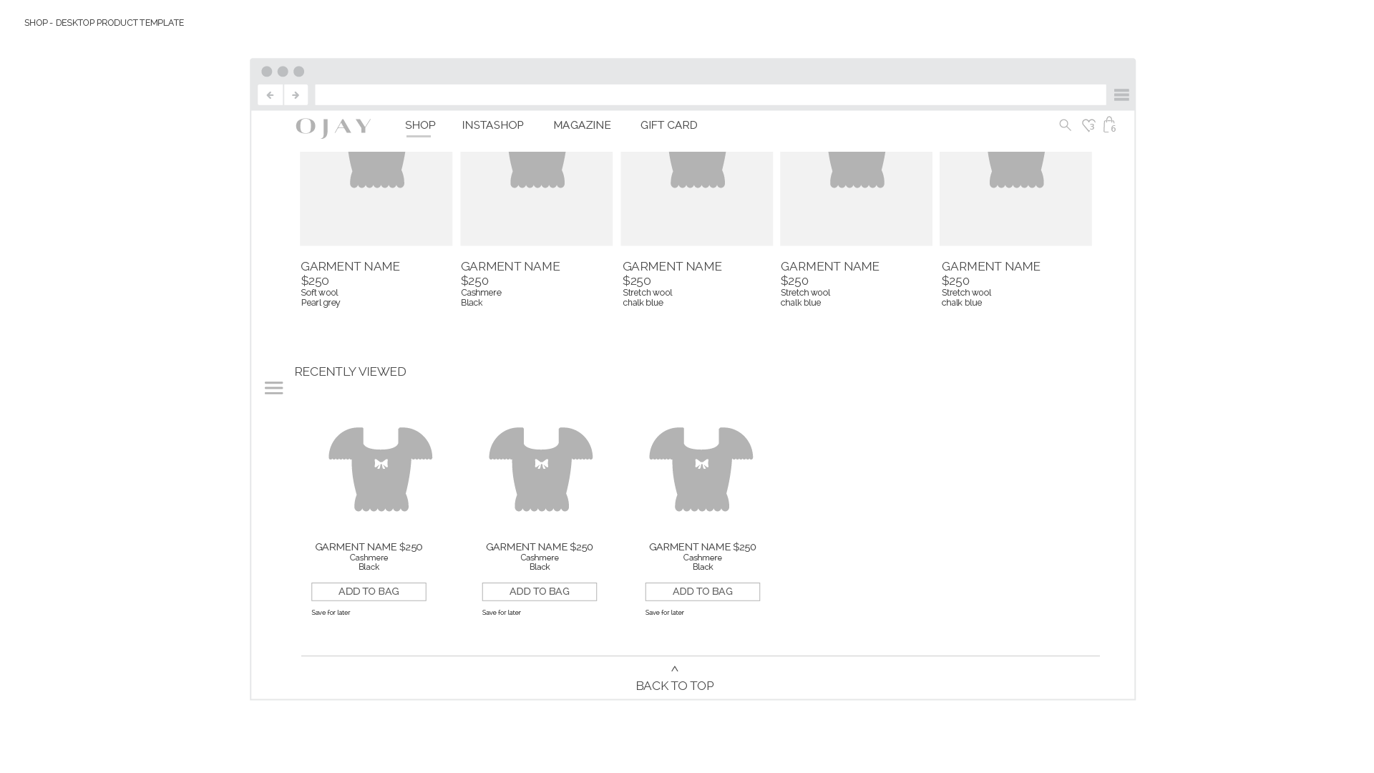
OJAY WEBSITE INFORMATION ARCHITECTURE

Slide 36
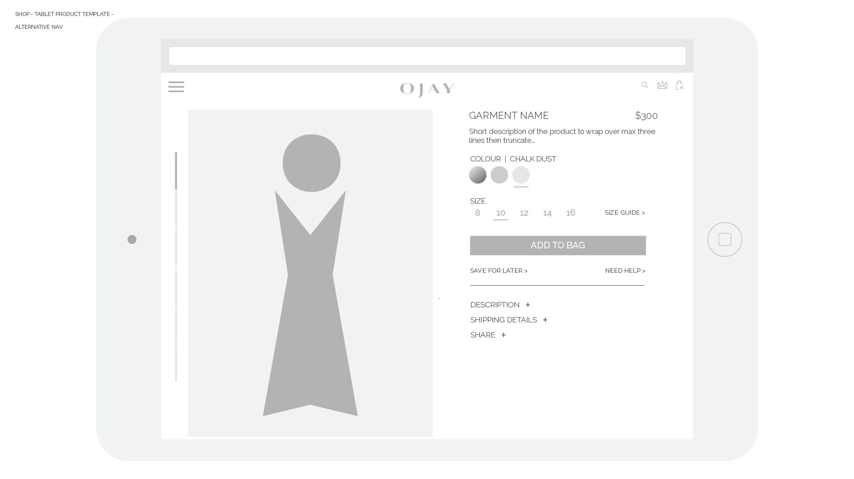
OJAY WEBSITE INFORMATION ARCHITECTURE

Slide 37
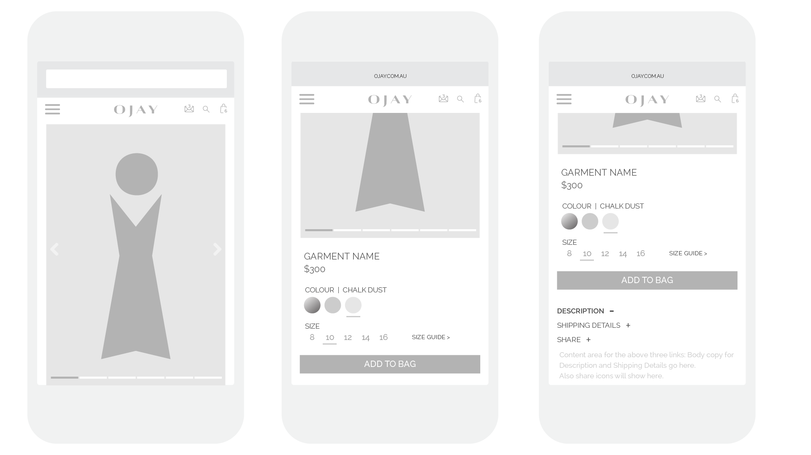
OJAY WEBSITE INFORMATION ARCHITECTURE

Slide 38
INSTASHOP

Slide 39
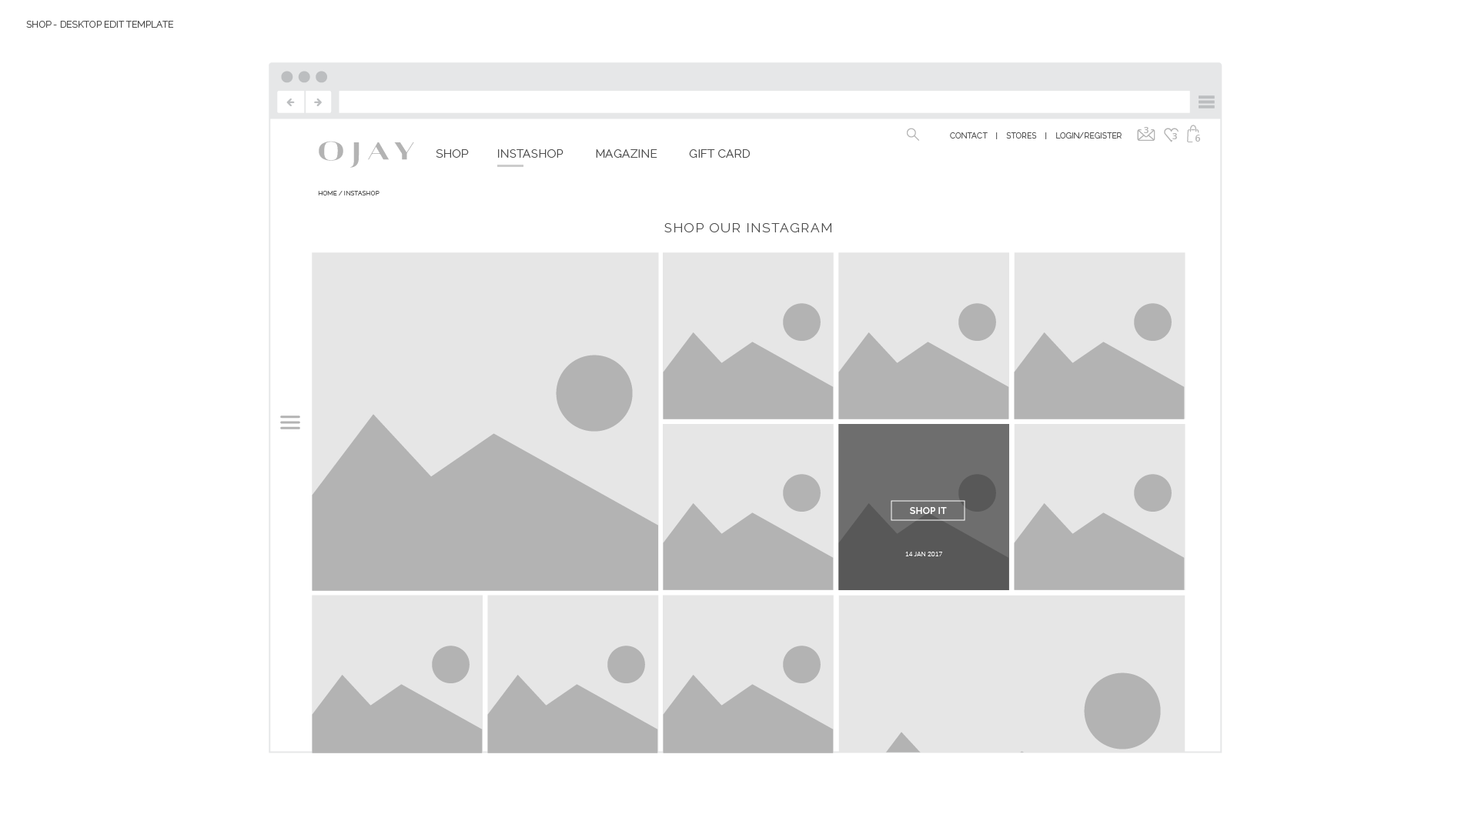
INSTASHOP LANDING PAGE
> Lookbook template grid
Hover state with click through to shop and date of post.
OJAY WEBSITE INFORMATION ARCHITECTURE

Slide 40
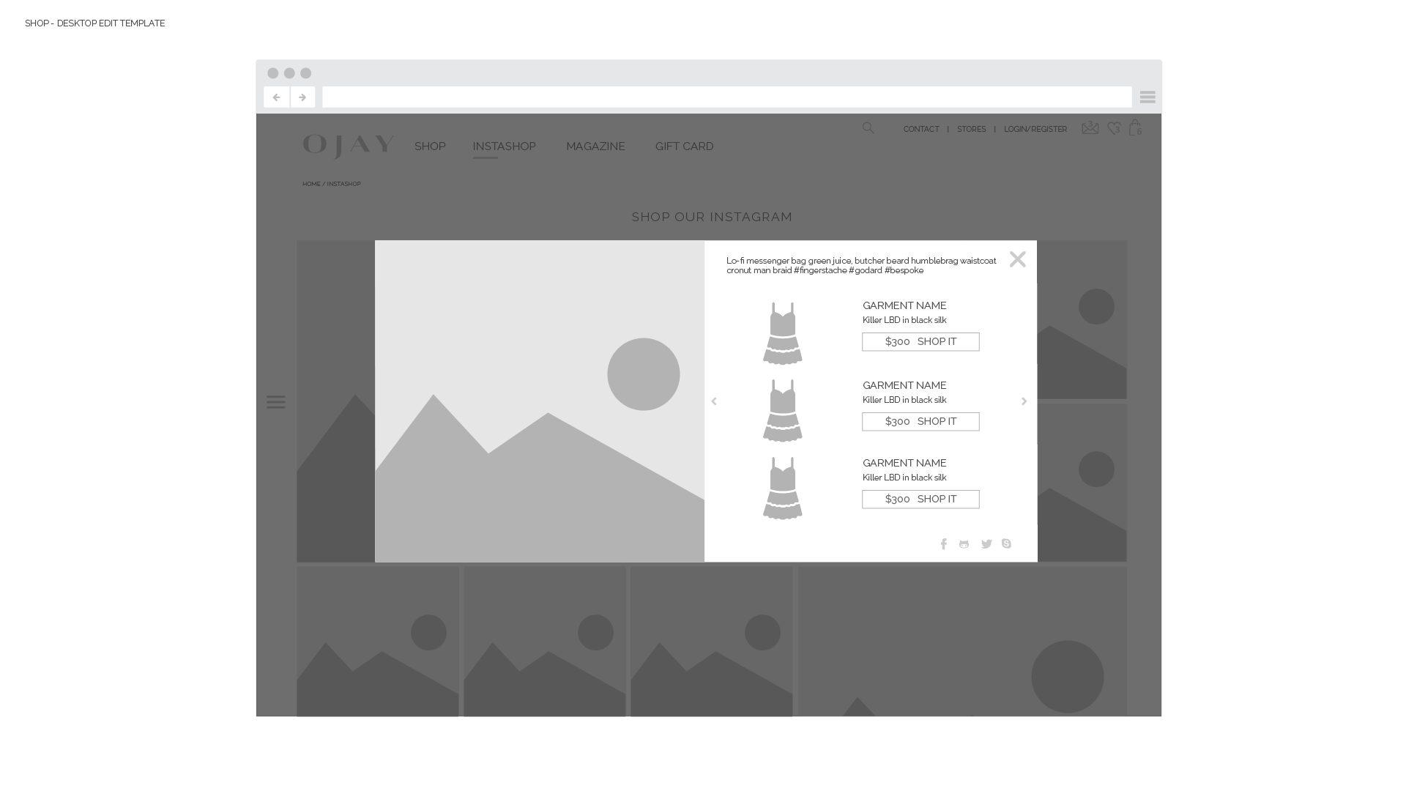
INSTASHOP POST MODAL
Overlay on current page with max three items tagged from the image.
Items link through to relevant product detail page.
Chevrons scroll through to next post in the modal view.
Original instagram post message (not subsequent messages) are included in the details.
OJAY WEBSITE INFORMATION ARCHITECTURE

Slide 41
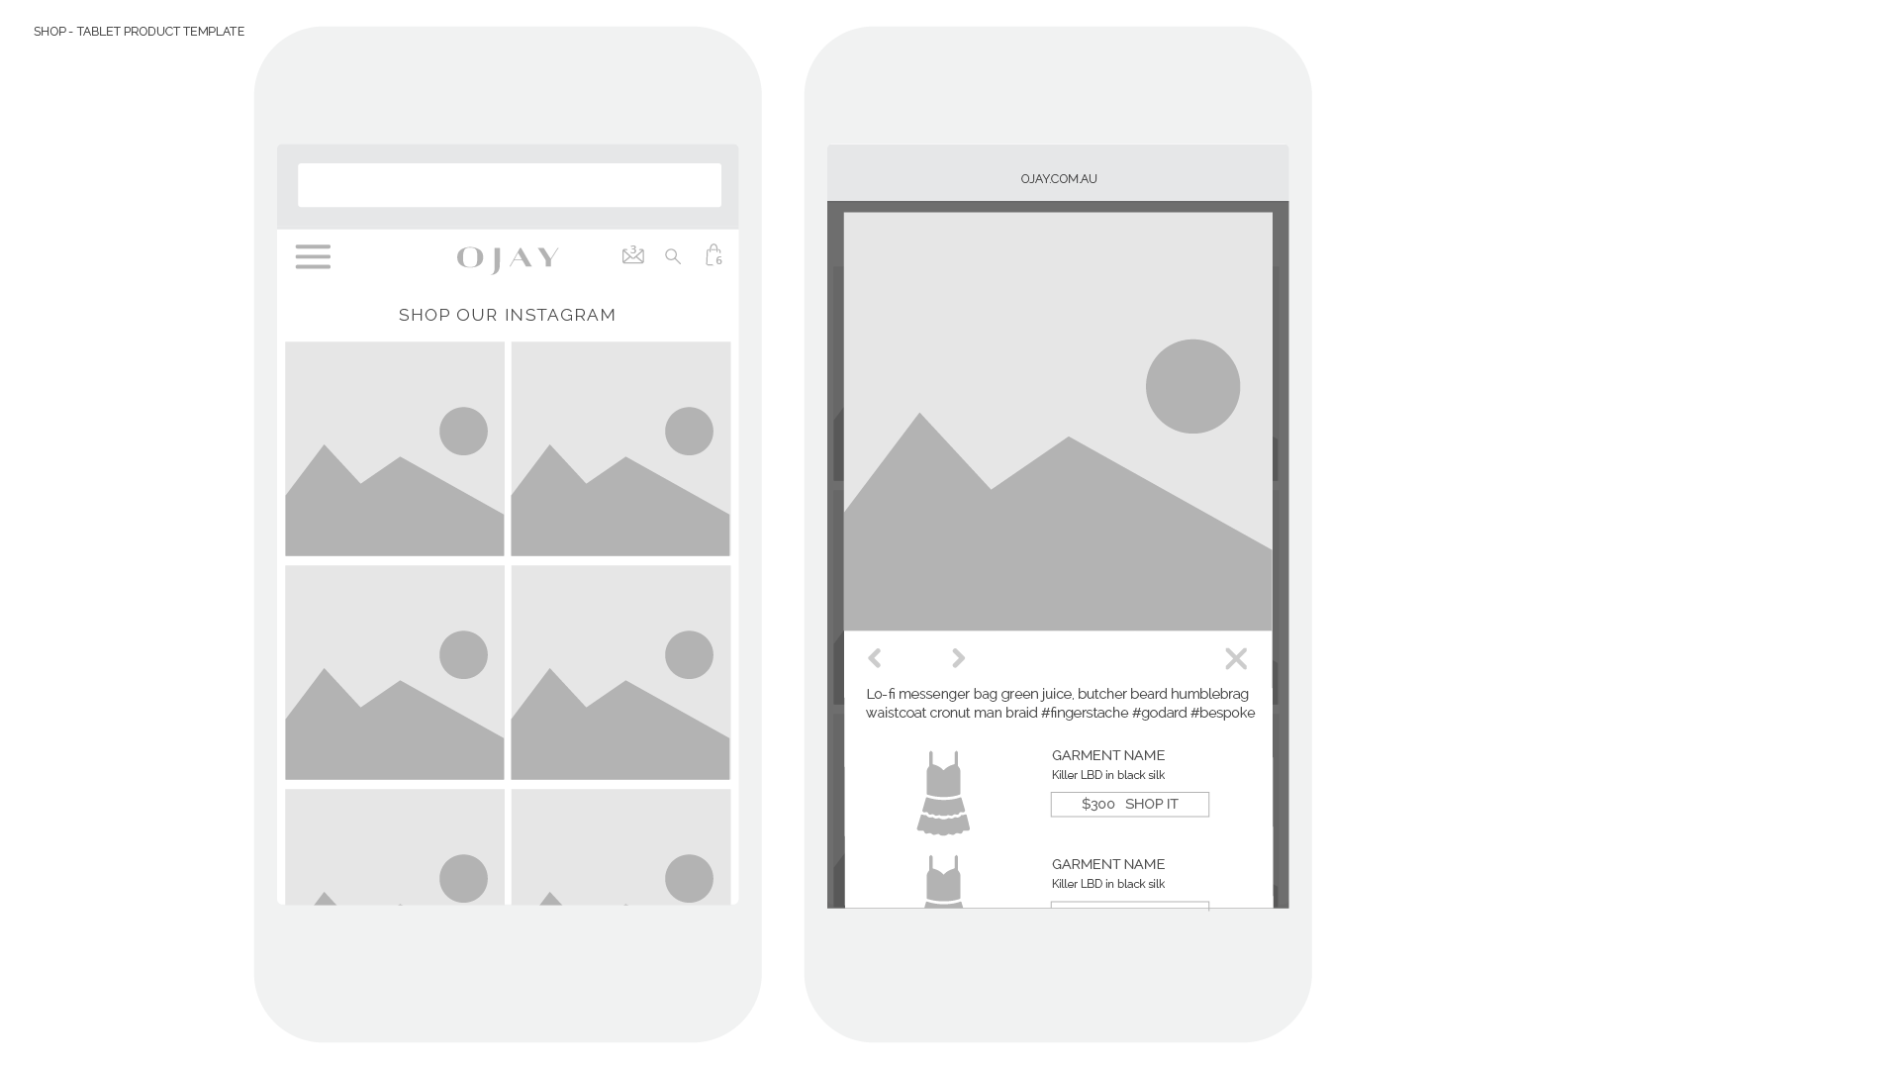
INSTASHOP LANDING AND POST PAGE ON MOBILE
The post modal is responsive to mobile. All content stacks.
OJAY WEBSITE INFORMATION ARCHITECTURE

Slide 42
GIFT CARD

Slide 43
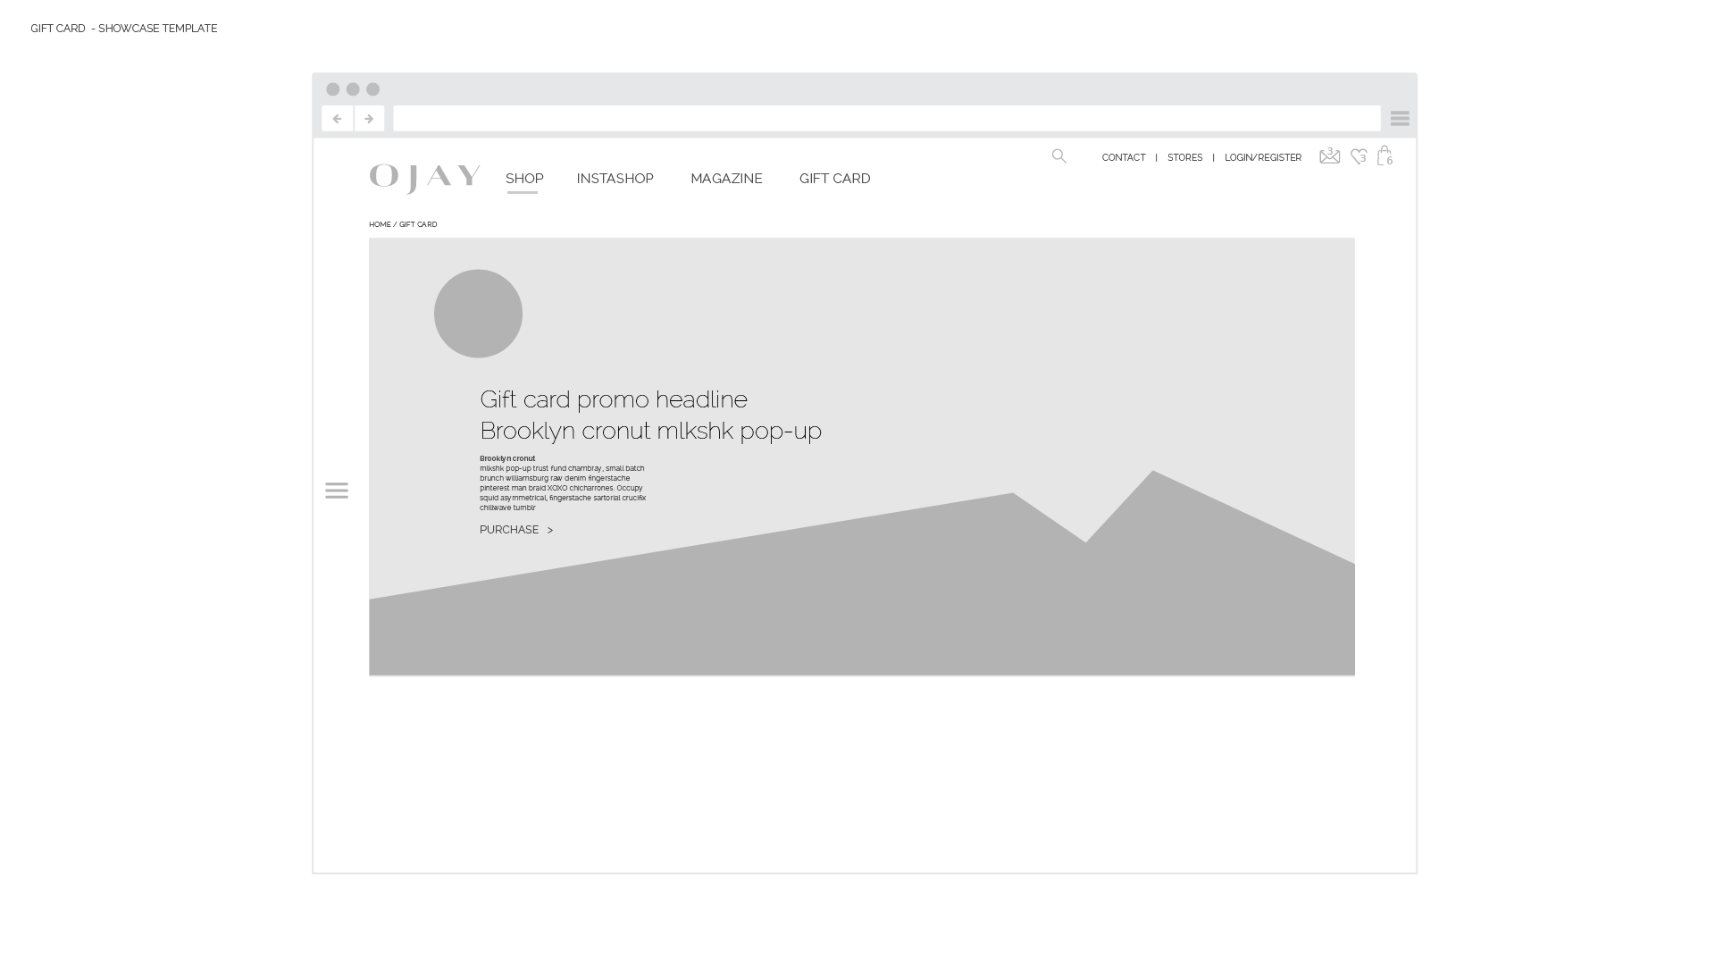
GIFT CARD LANDING PAGE
> Product category template
The gift card landing page uses the same template as the Product category page.
The header image is responsive with HTML headline, body text and a link to the purchase page.
No thumbnails for products are loaded into this page. This section should collapse to reveal the footer below.

Slide 44
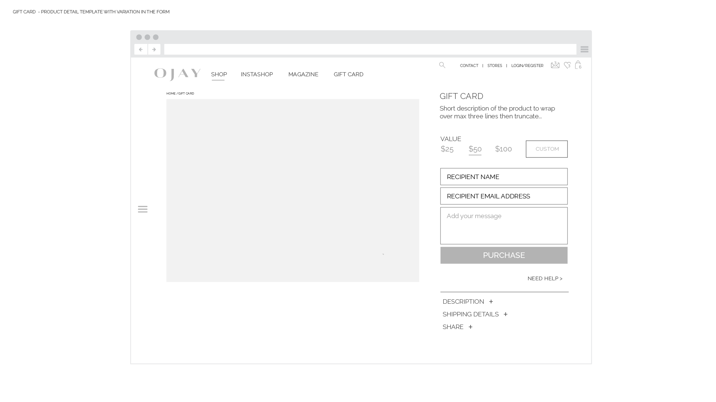
GIFT CARD PURCHASE PAGE
> Product detail template
The gift card purchase page uses the product detail template from the Shop, with some changes in the form on the right.
Remove Size and colour fields.
Add Value with a custom field to add your own value.
New fields for recipient name, email and a message.
The “Purchase” button will take you directly to the checkout, by-passing the cart.
The left side image stage shows a single image here, full width of the stage. (The normal template used two images).
The recipient receives a promo code that can be used in payment page

Slide 45
LOGIN INTERACTIONS

Slide 46
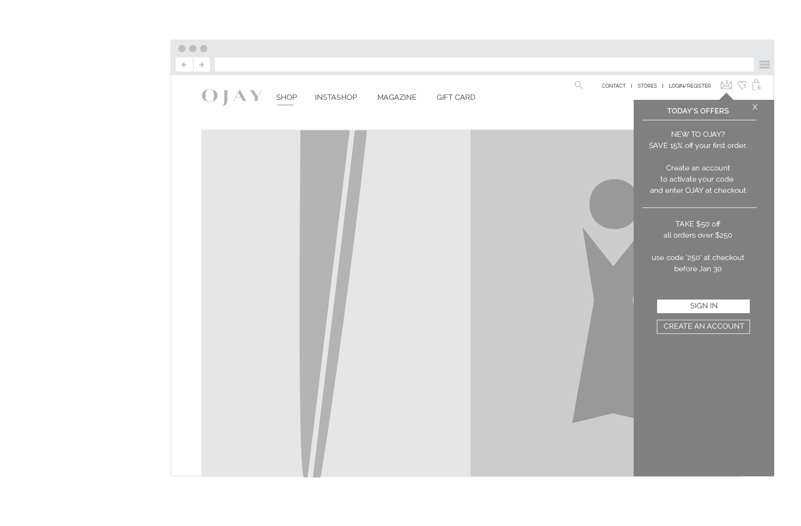
These menu items are relative to right edge of browser
SIDEBAR INTERACTIONS
DESKTOP - ON HOVER
MOBILE & TABLET - ON TOUCH
The interactions for these menu items slide in from right side of browser on all devices. The top of the container points to the menu items it refers to.
NEWS & OFFERS MESSAGES
These messages are added in the CMS.
New visits and return visits that have not yet viewed, will see the indicator for “unread messages” in red.
If already viewed, the messages remain and the number remains, but the colour returns to normal text colour.
OJAY WEBSITE INFORMATION ARCHITECTURE

Slide 47
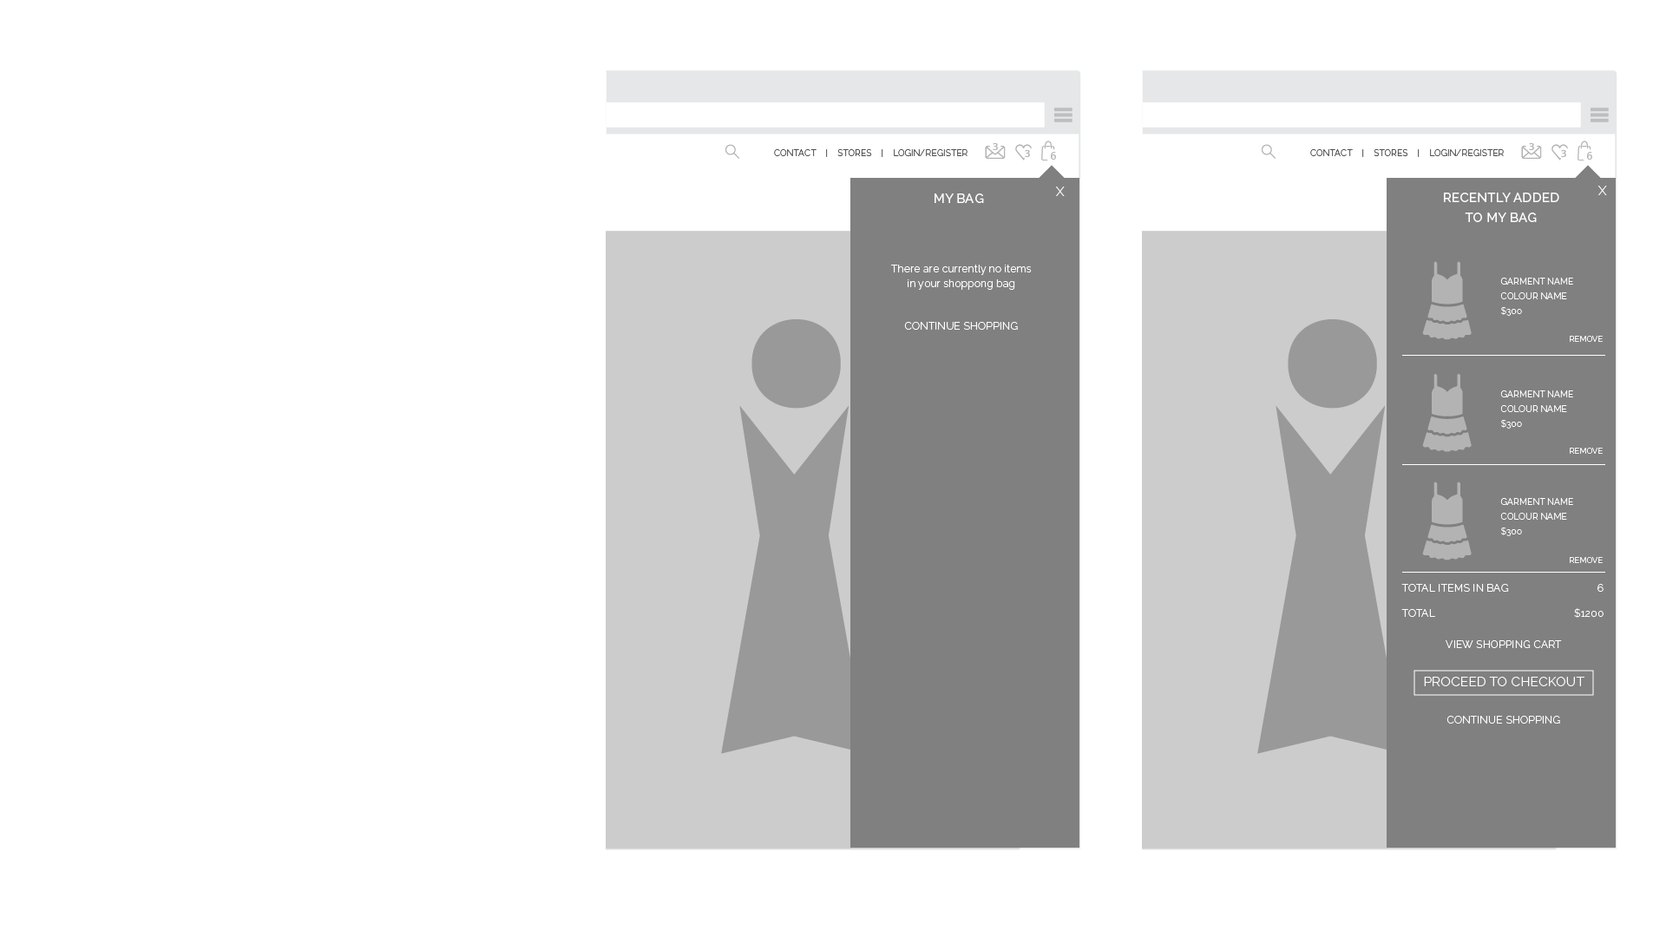
MY BAG INTERACTIONS
The last three items added to the shopping bag will show in the side bar.
The total value of the bag will also show, with a link to the checkout - this will open the Shopping bag page at the front of the checkout process.
If there are more than 3 items in the bag, a message will show above the total, to indicate it is the total for the whole number of items in the shopping bag.
OJAY WEBSITE INFORMATION ARCHITECTURE

Slide 48
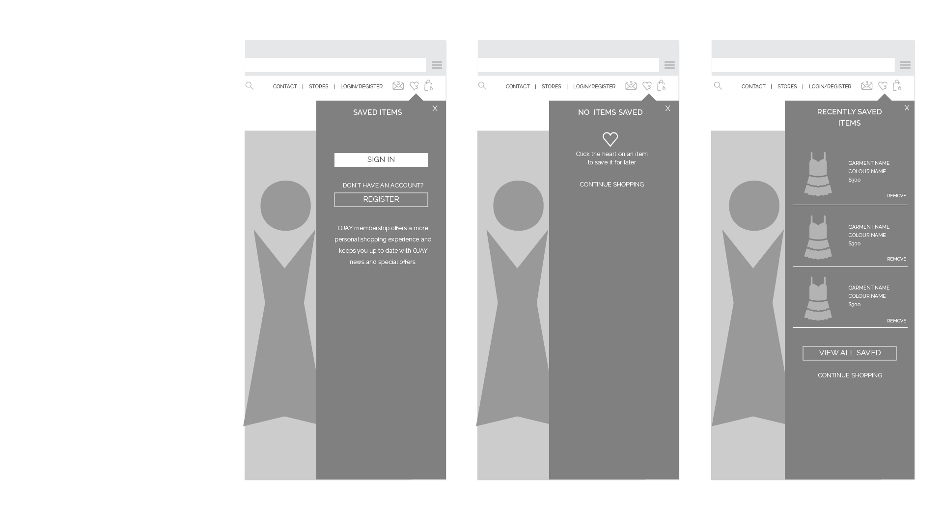
SAVED ITEMS INTERACTIONS
Users need to sign in to access their saved items.
If possible, users should be able to save items in the logged out state, but once they try to view, the should be prompted to log in to view.
ON HOVER of the icon at top left, the drawer slides out showing saved items, or none saved message.
If not logged in, the log in message slides out.
ON CLICK/TOUCH the Saved items page will open.
If not logged in, the login prompt will open
OJAY WEBSITE INFORMATION ARCHITECTURE

Slide 49
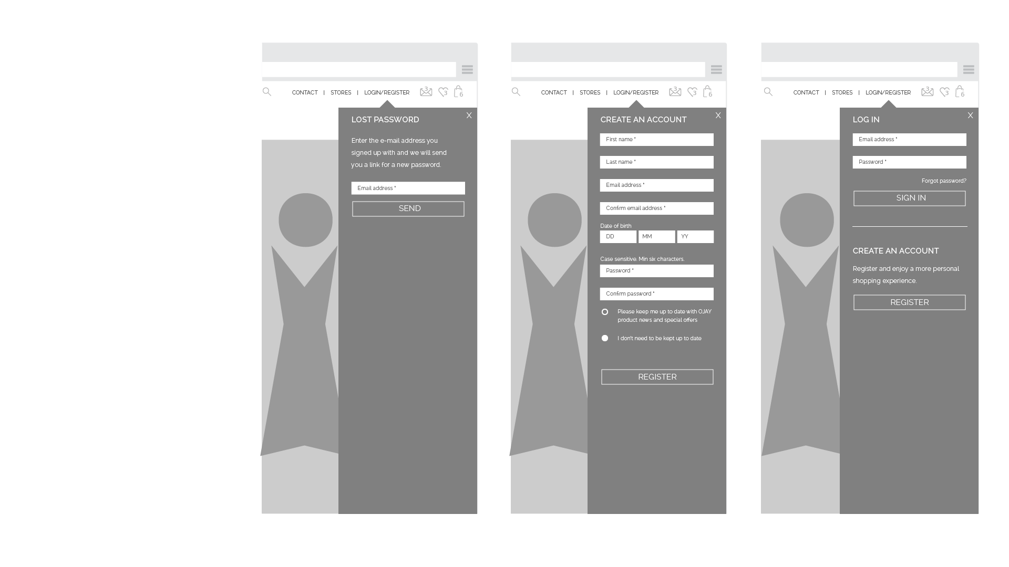
LOGIN & REGISTER
ON HOVER - DESKTOP
The side bar slides out to log in.
If user chooses register or lost password, the content changes in the sidebar as shown.
ON CLICK - ALL DEVICES
If already logged in, the menu will show as “my account” and will link to the account page.
If not logged in, the Login register menu will open the side bar if clicked.
OJAY WEBSITE INFORMATION ARCHITECTURE

Slide 50
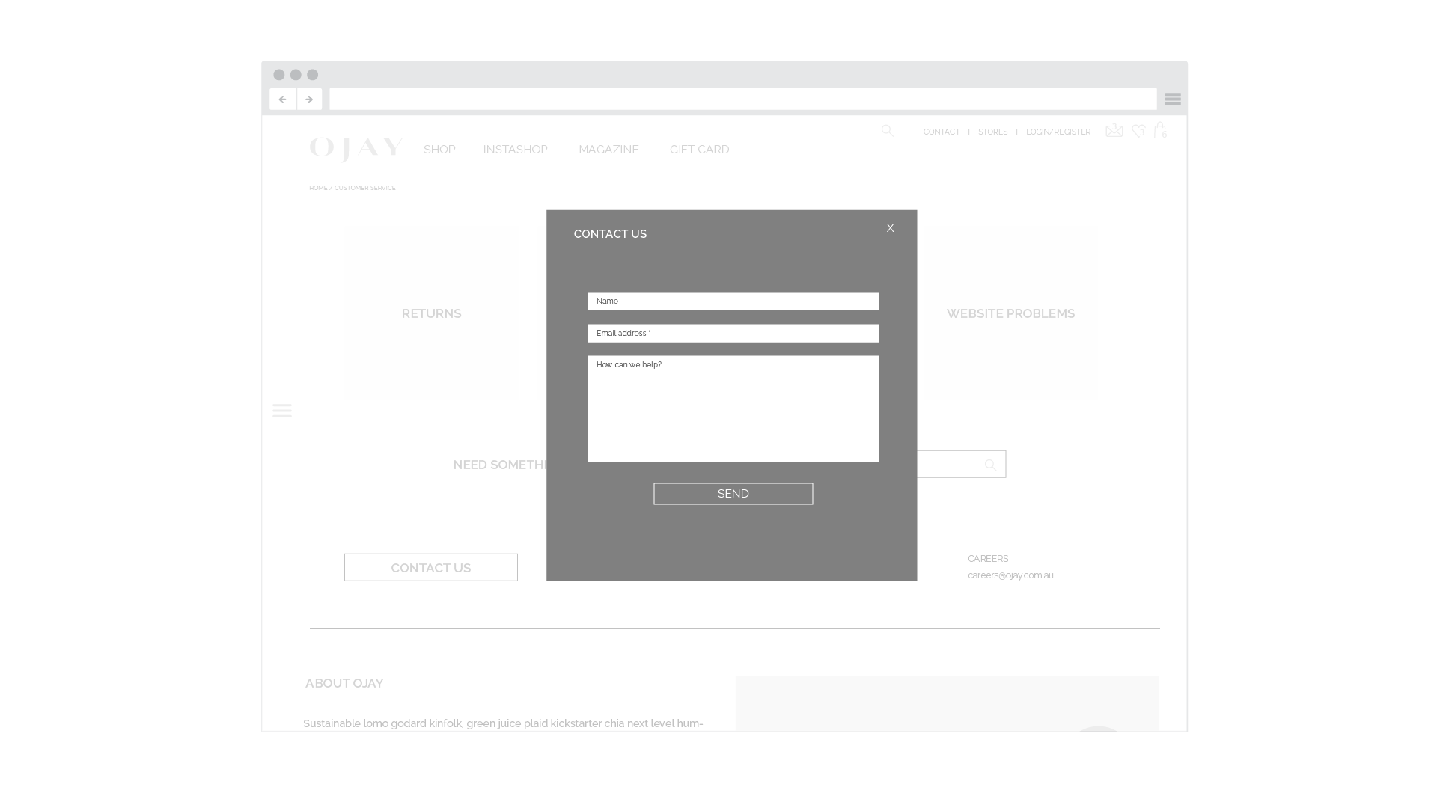
CONTACT US FORM
Clicking the contact us in the top right will open this form.
Basic email form as a modal.
OJAY WEBSITE INFORMATION ARCHITECTURE

Slide 51
CUSTOMER SERVICE

Slide 52
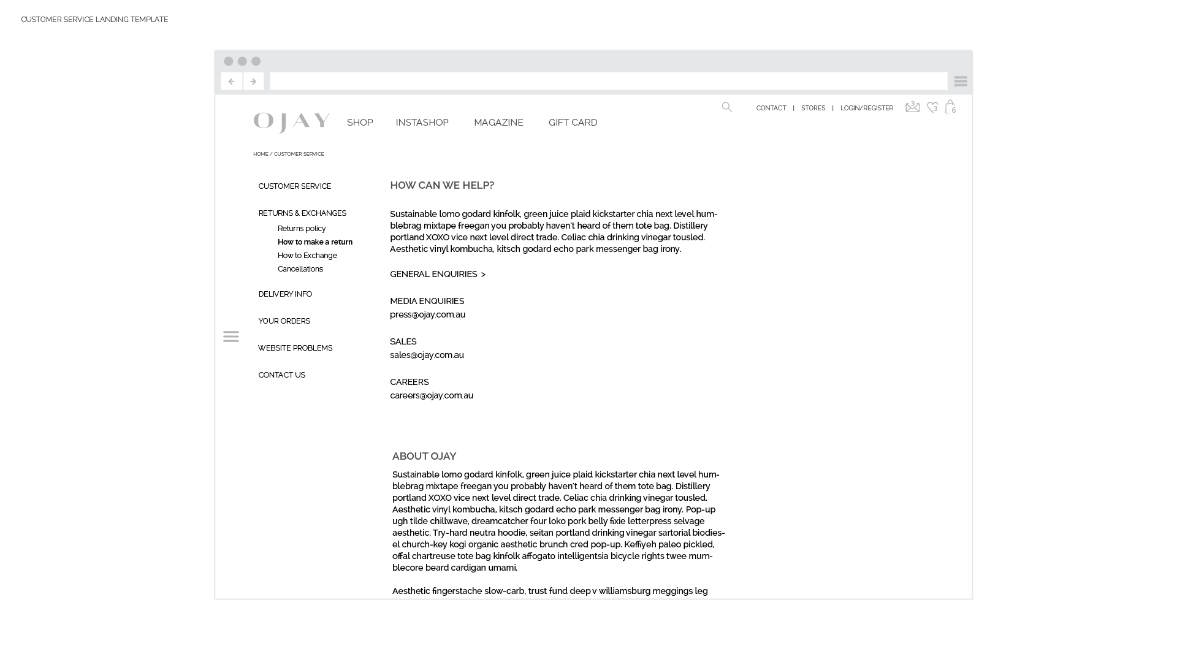
CUSTOMER SERVICE LANDING PAGE.
Sidebar menu links to all the customer service pages.
The pages all use this same template.
OJAY WEBSITE INFORMATION ARCHITECTURE

Slide 53
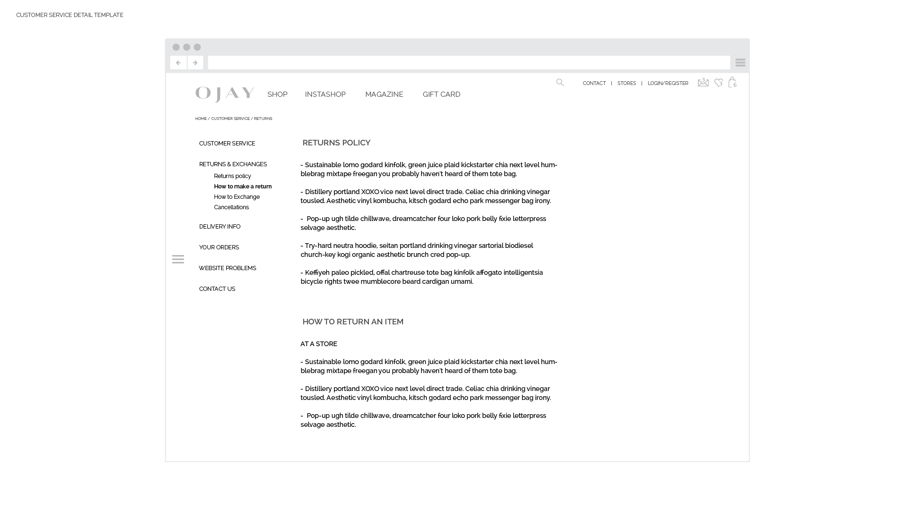
RETURNS POLICY
OJAY WEBSITE INFORMATION ARCHITECTURE

Slide 54
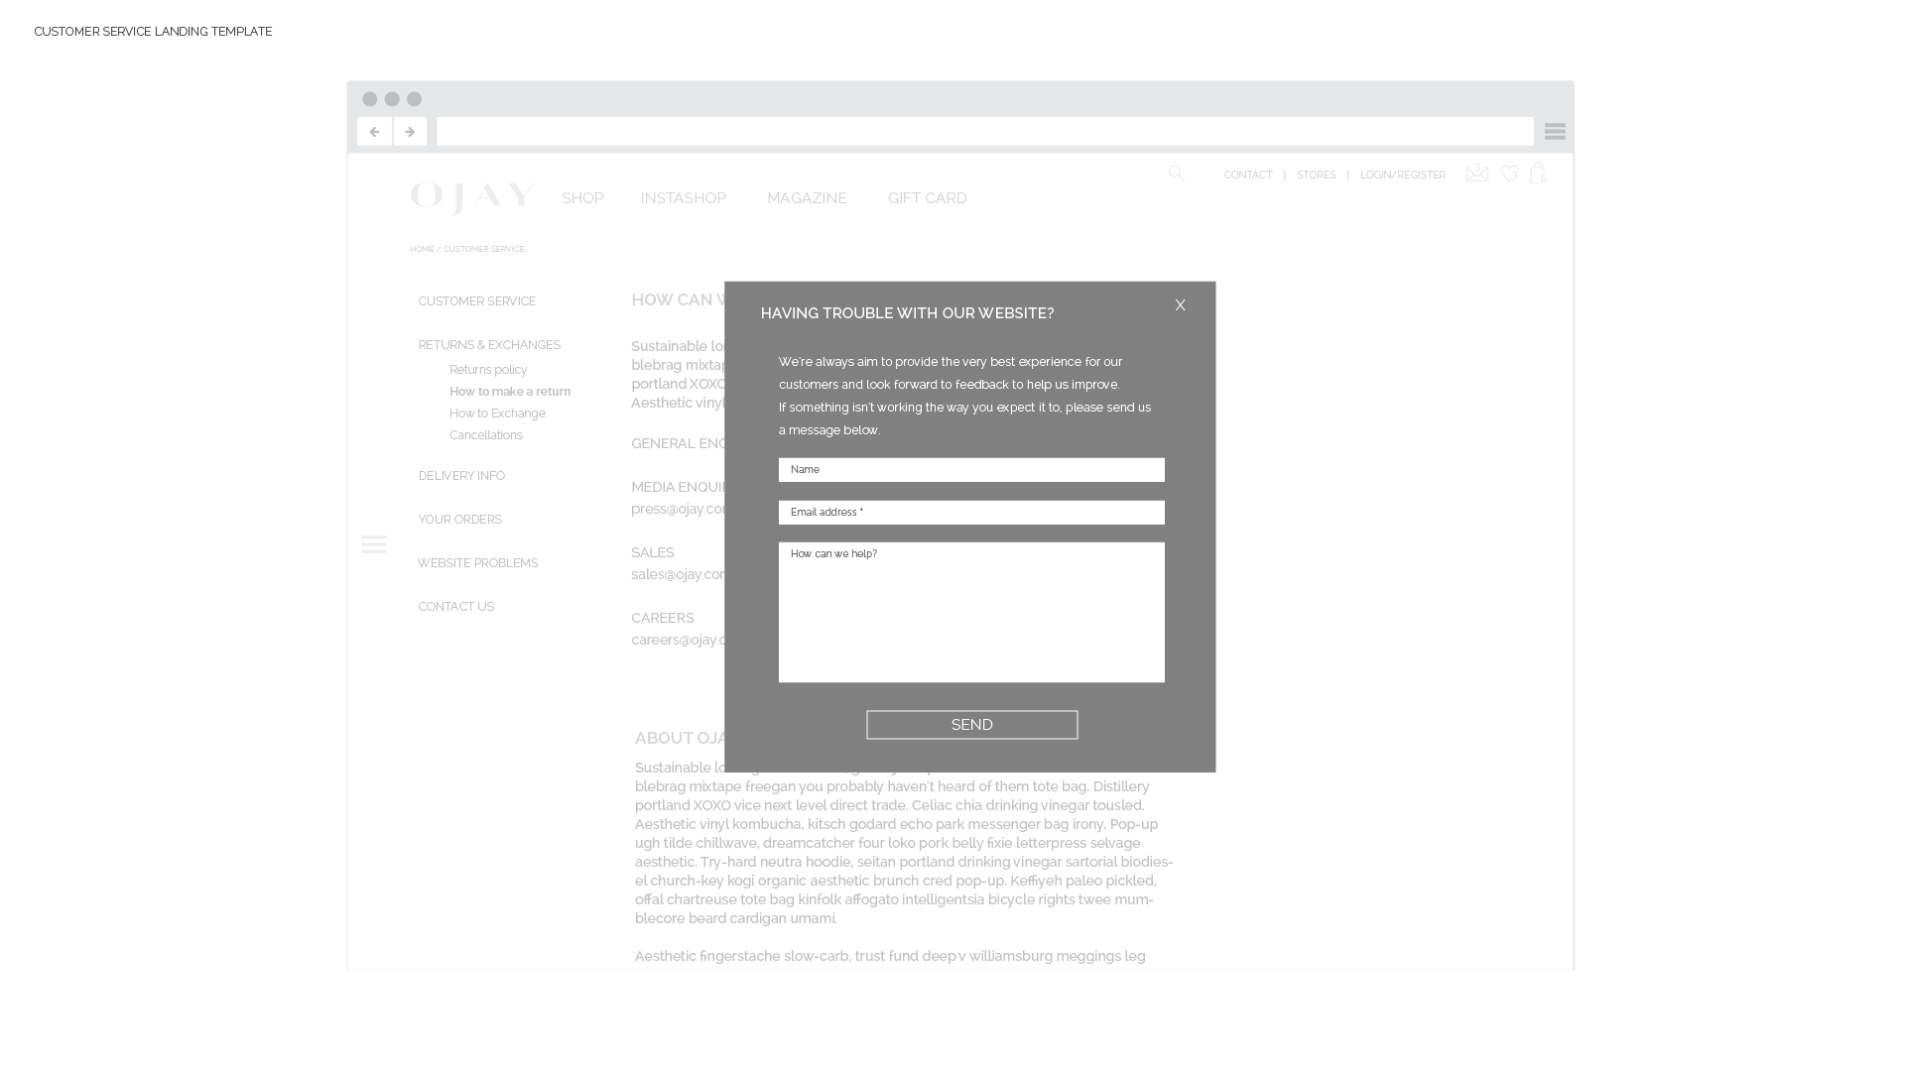
CONTACT US FORM
Content changed at top of form to be specific to reporting web issues.
This form should send to an address dedicated to web issues.
OJAY WEBSITE INFORMATION ARCHITECTURE

Slide 55
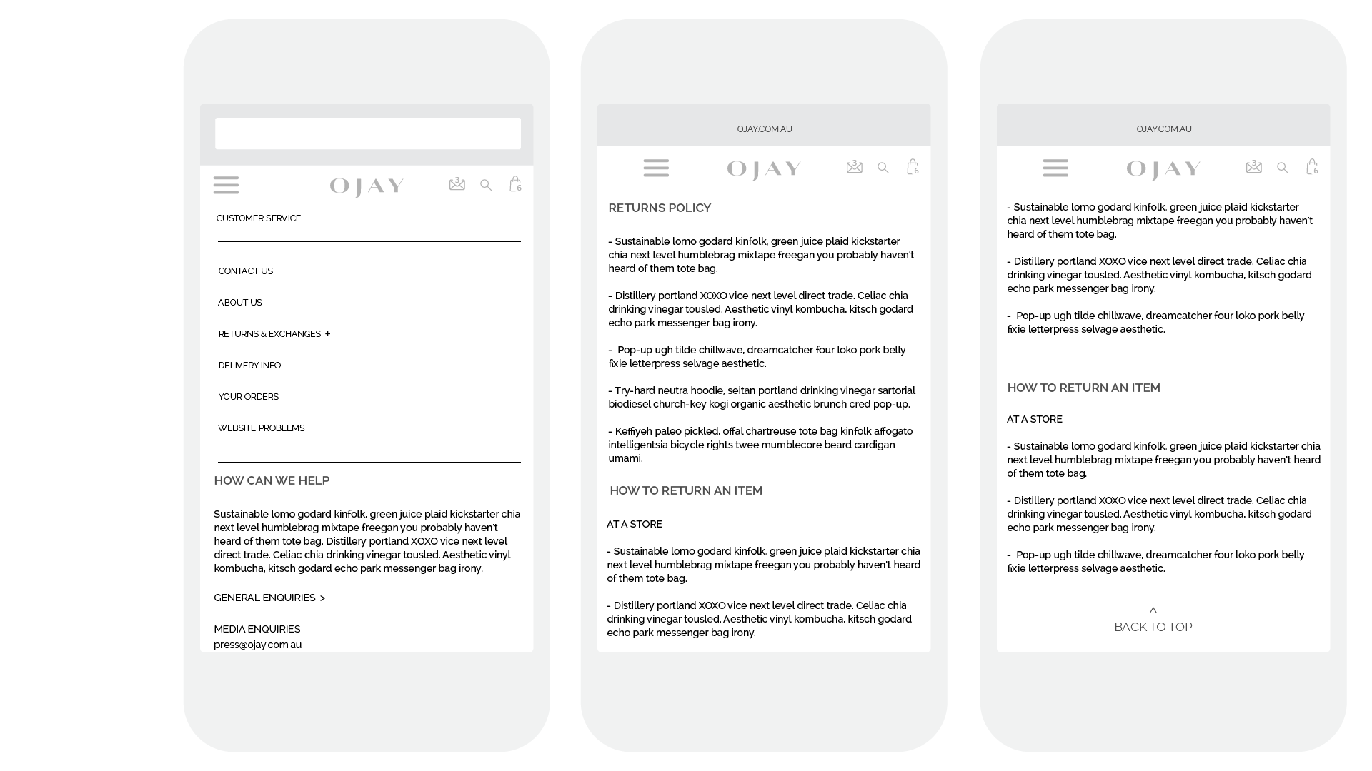
OJAY WEBSITE INFORMATION ARCHITECTURE

Slide 56
FOOTER & ERROR PAGE

Slide 57
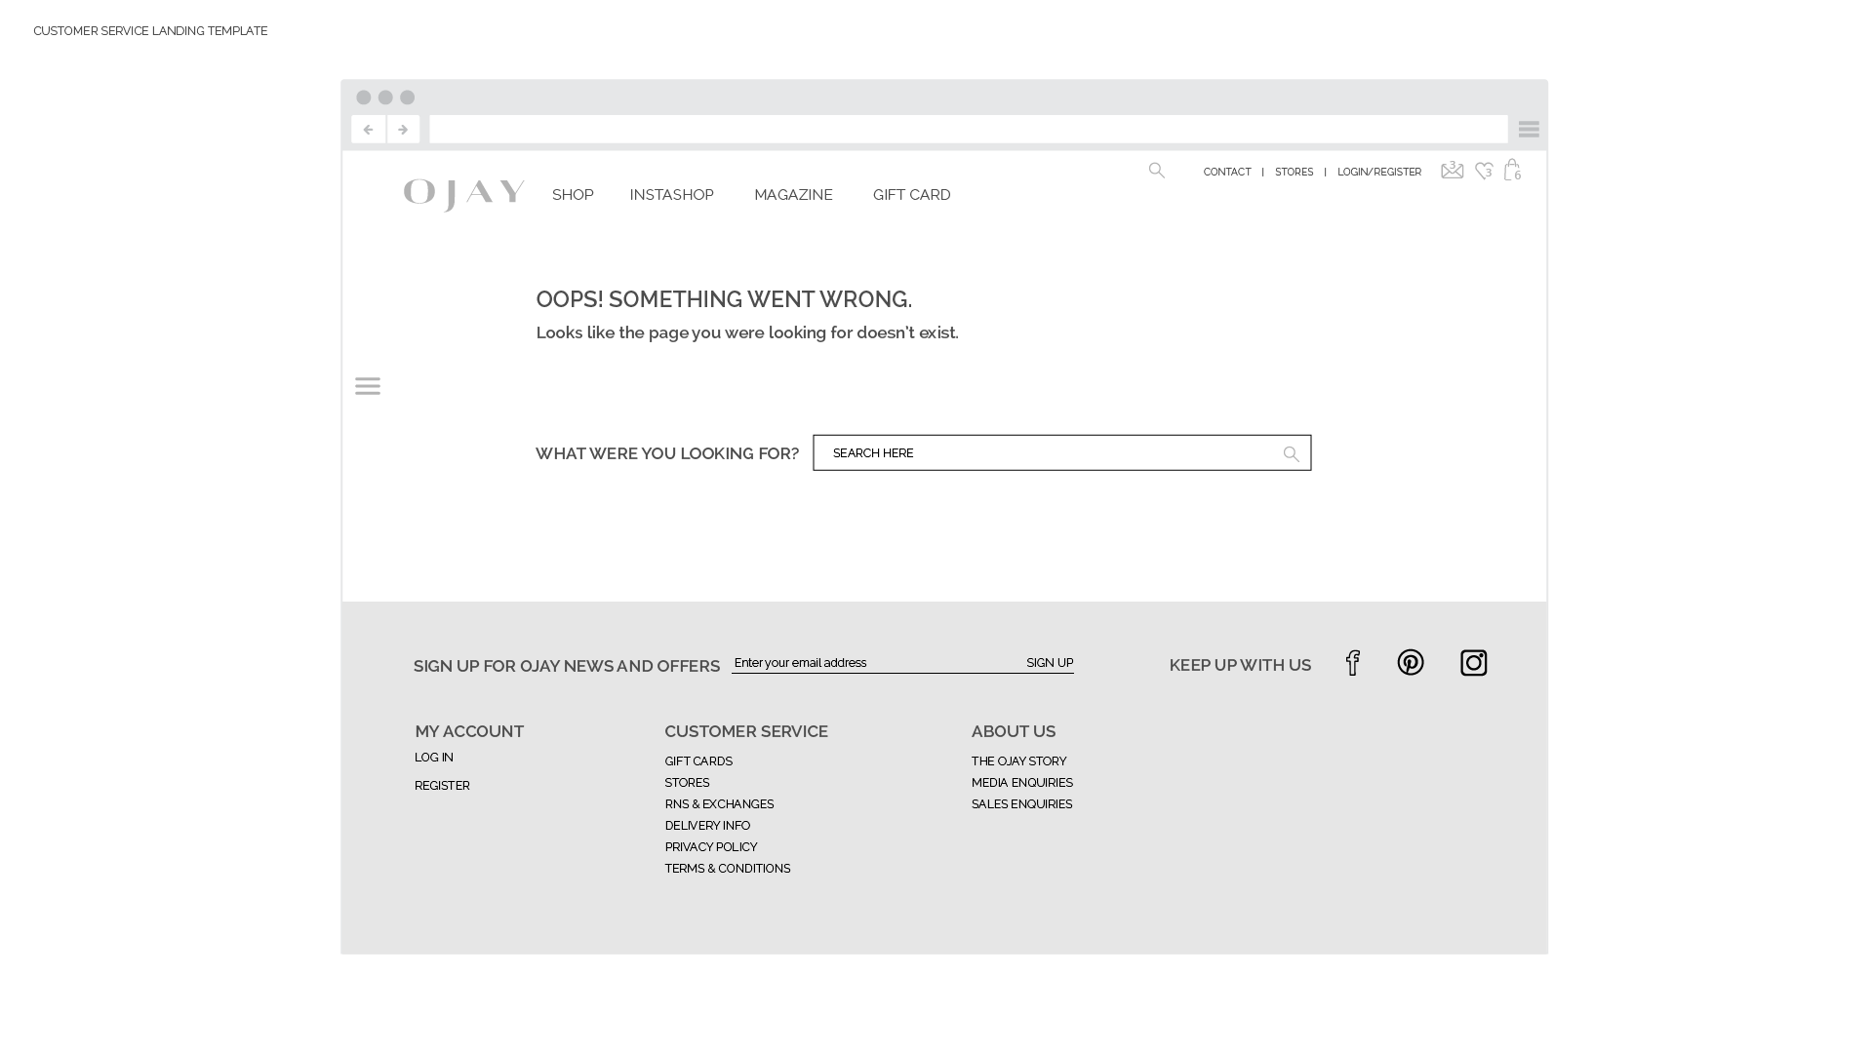
The footer is displayed on all pages in the site.
OJAY WEBSITE INFORMATION ARCHITECTURE

Slide 58
NEXT STEPS
Checkout experience (pending software templates)
Design for user interface

